Slide 1
Amazon Web Services
K.Varshika Kumari

Slide 2
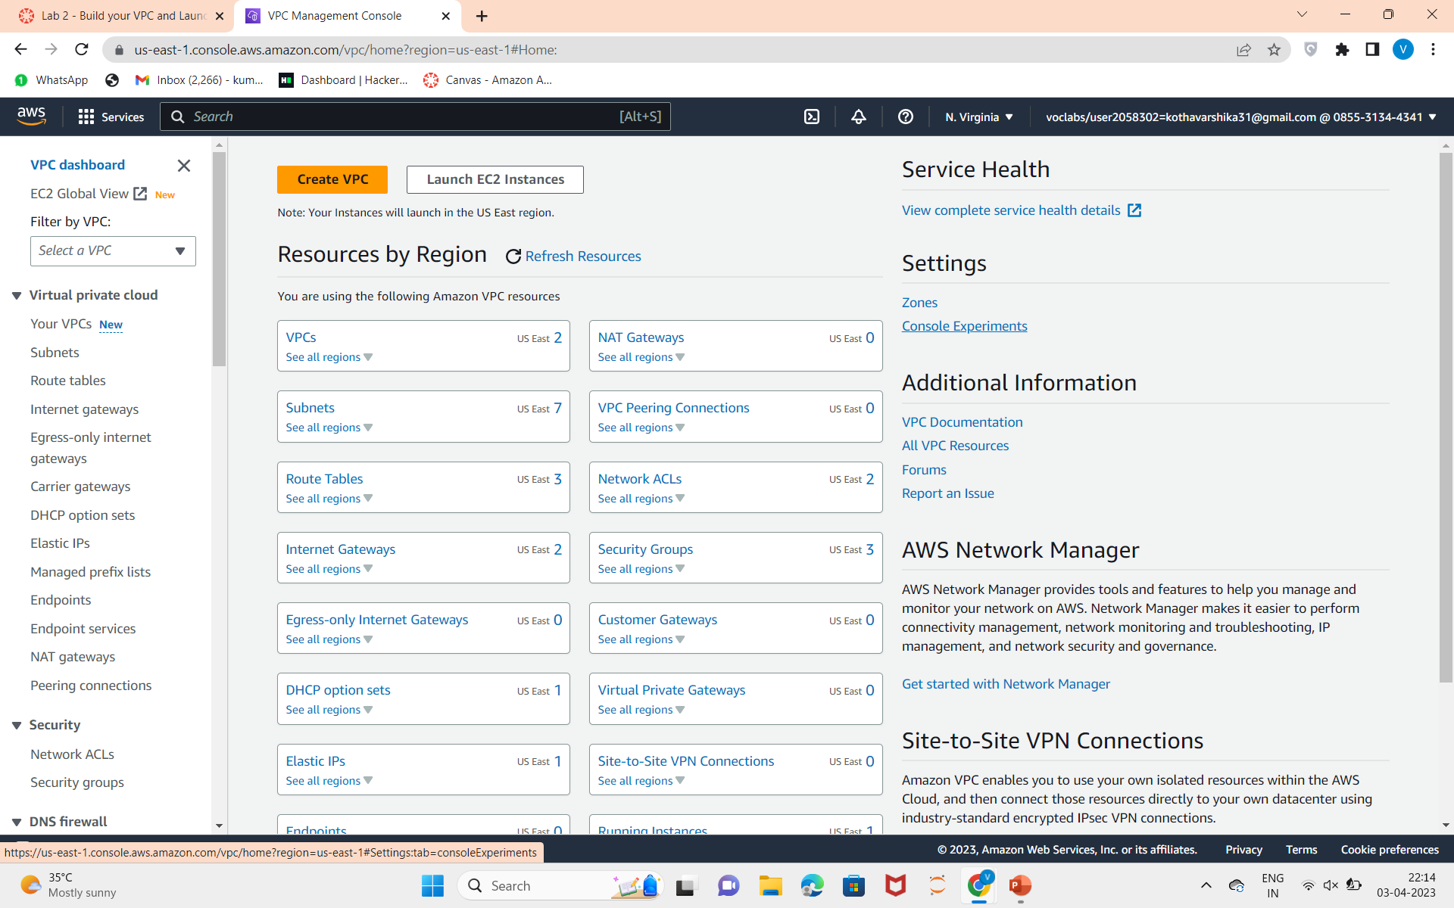
Virtual Private Cloud(VPC):
After logging into the AWS Academy,launch the lab to work with VPC.
1.Click on the services and choose VPC

Slide 3
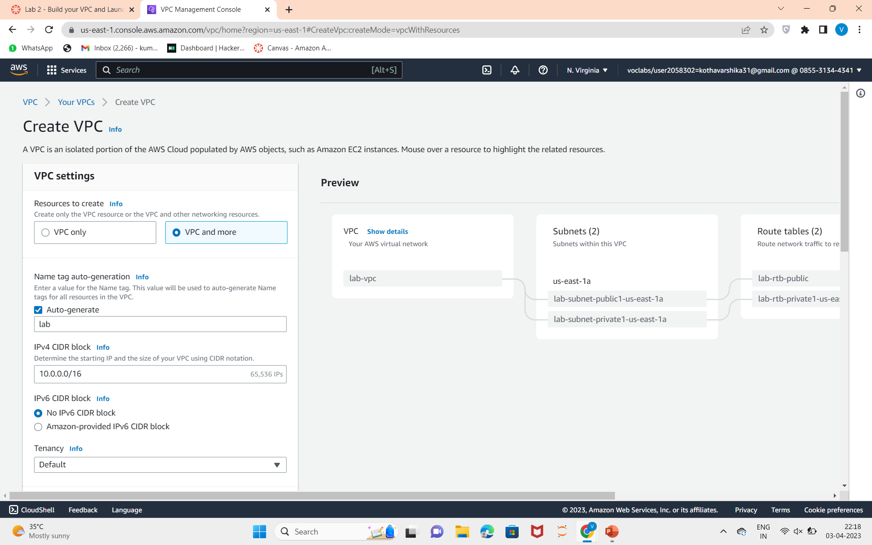
2.Click on create VPC and Create the VPC with the given requirements.

Slide 4
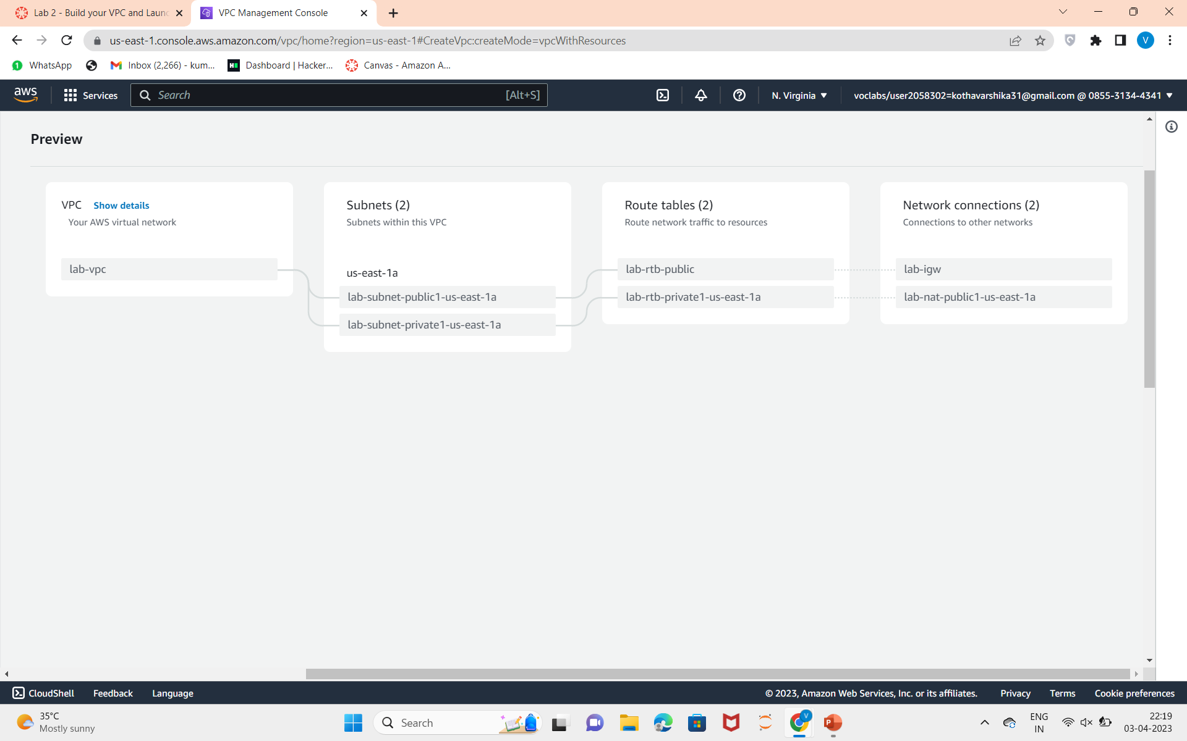
3.Review the created VPC in the review panel on right.
4.Click on create VPC.

Slide 5
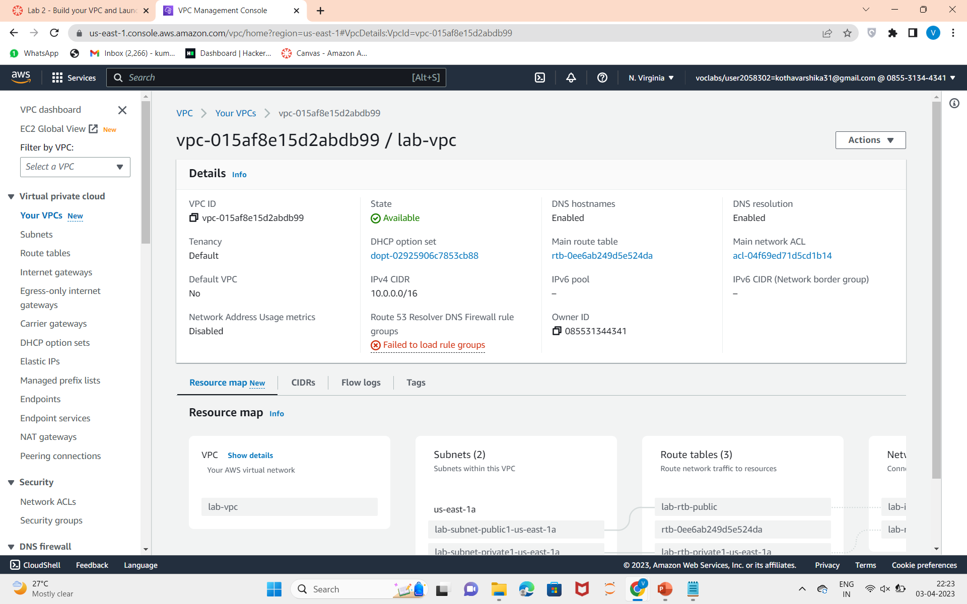
5.View the created VPC.

Slide 6
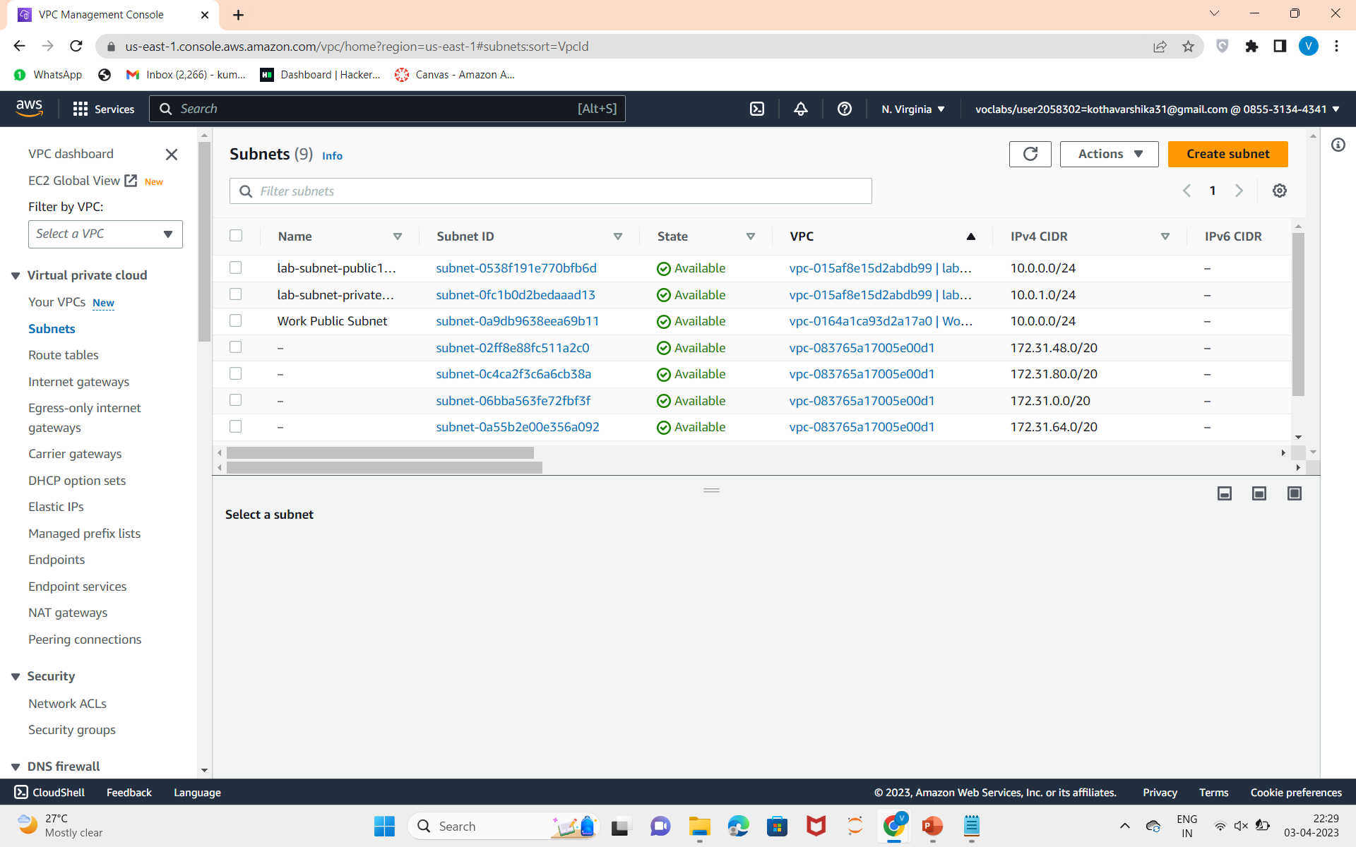
Creating Additional Subnets:
6.In the left navigation pane,choose Subnets,click on create subnet.

Slide 7
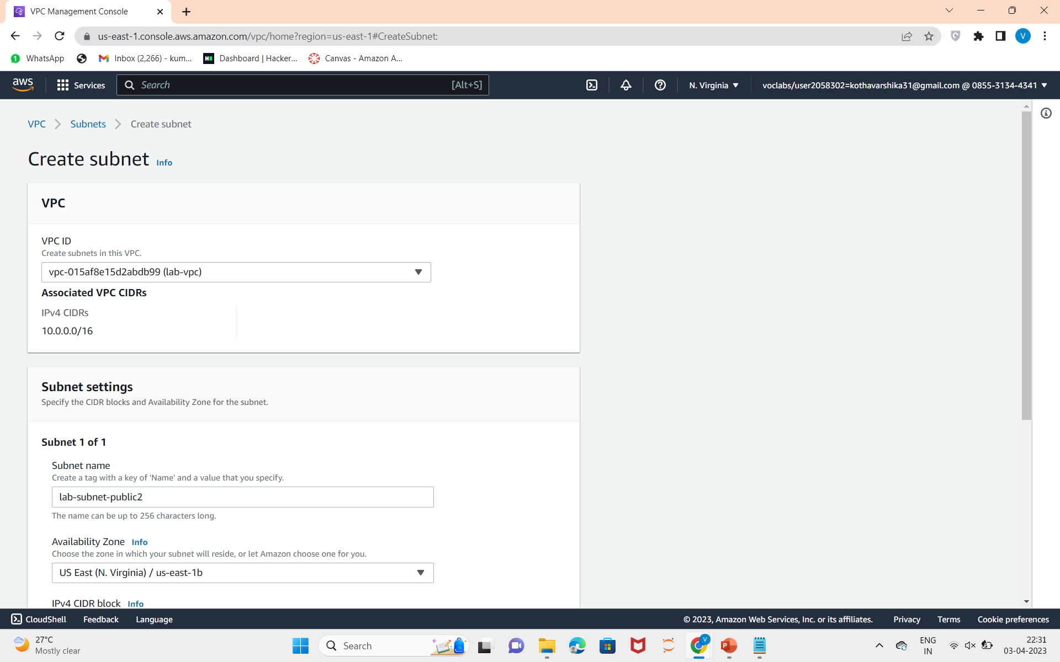
7.Create subnet by configuring with given requirements.

Slide 8
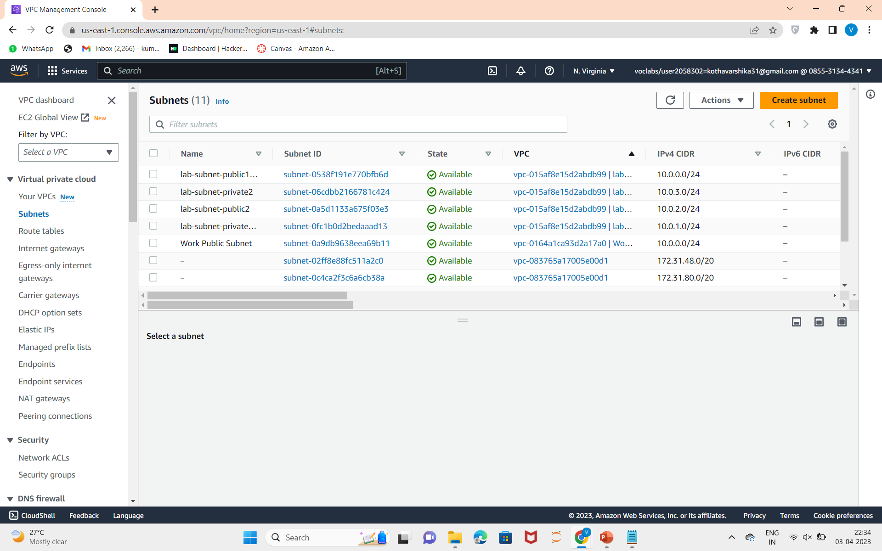
8.Subnet is created and select create subnet again and create with the given configurations.
9.Two subnets are created.

Slide 9
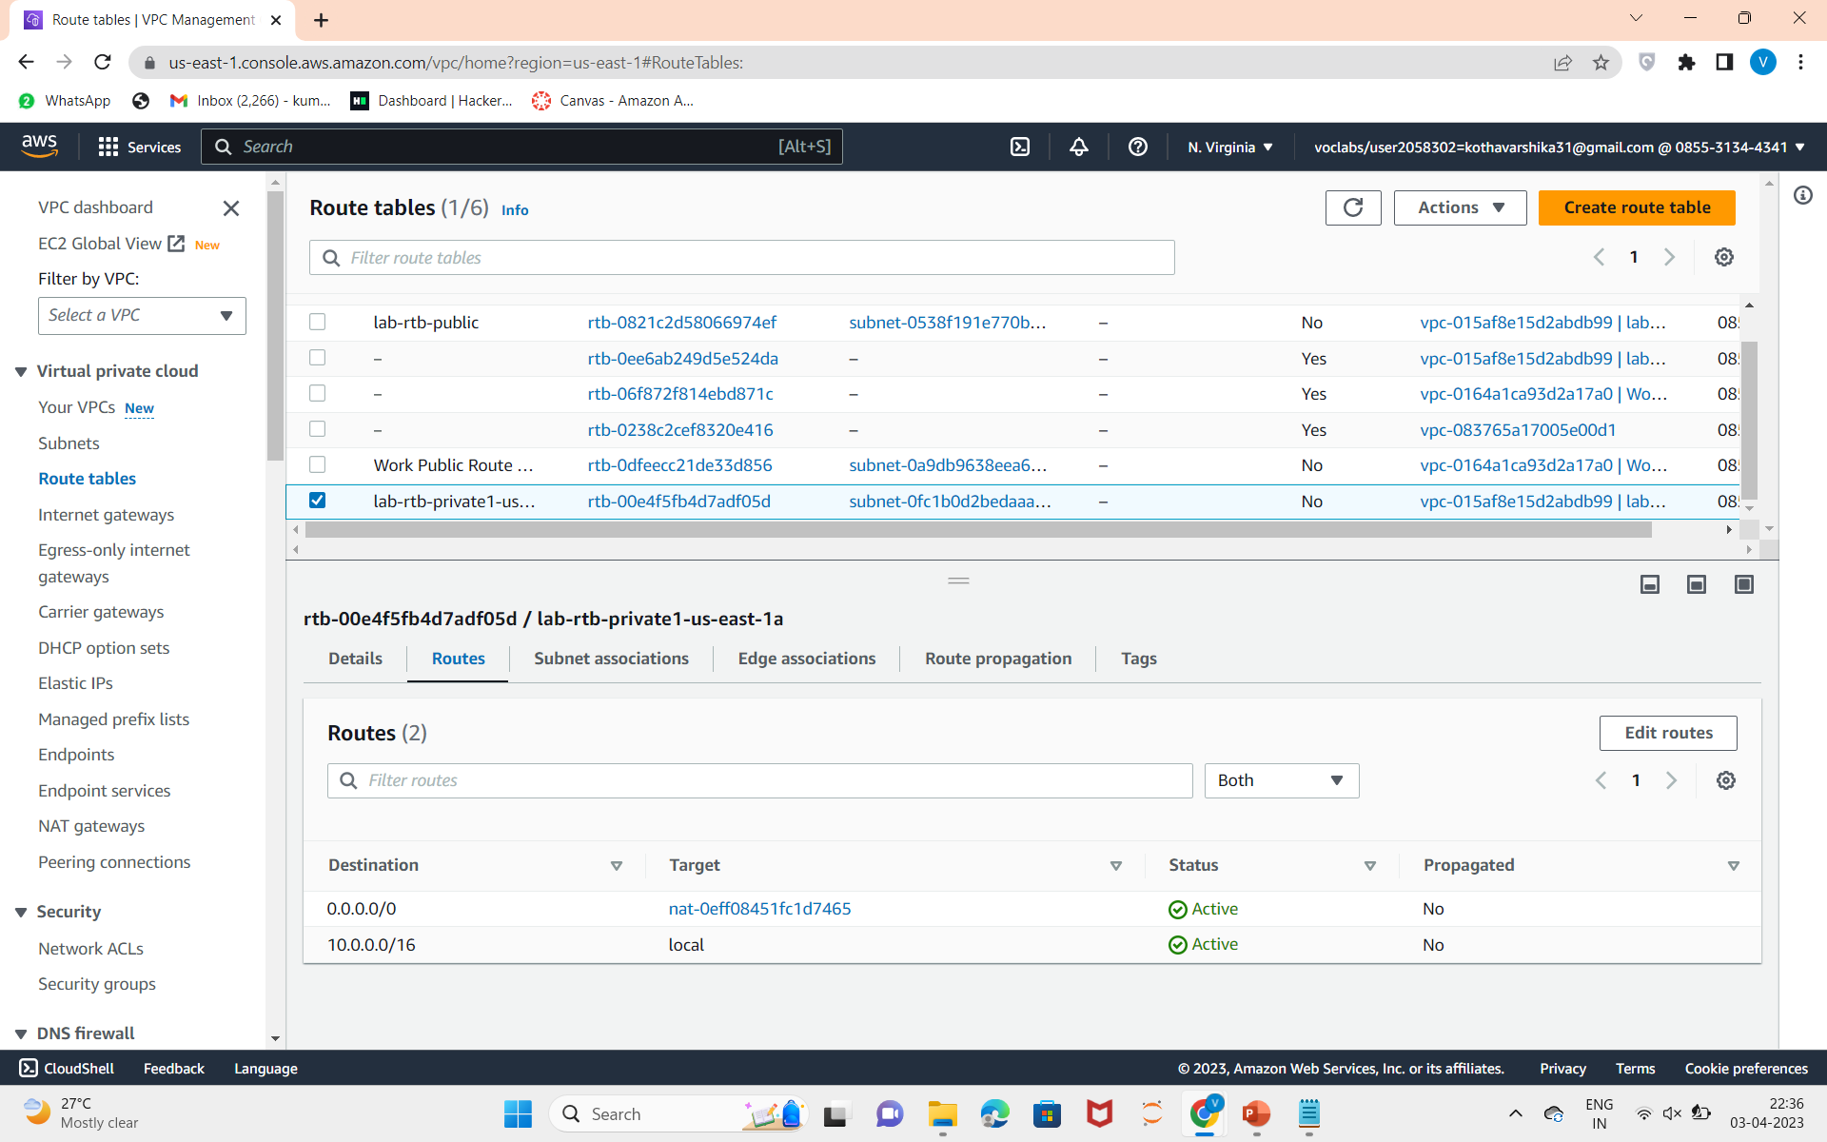
10.Choose route tables from the left navigation panel.Select lab-rtb-private1-us-east-1a and check destination and target.

Slide 10
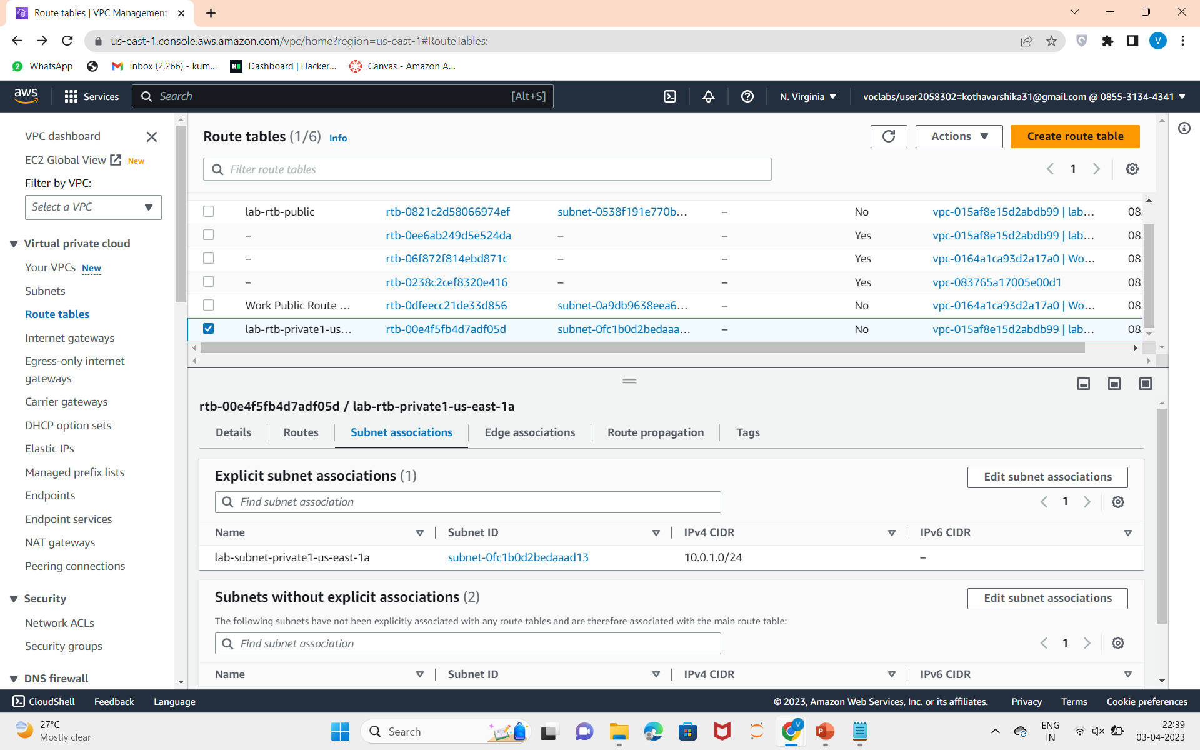
11.Then go to subnet associations.

Slide 11
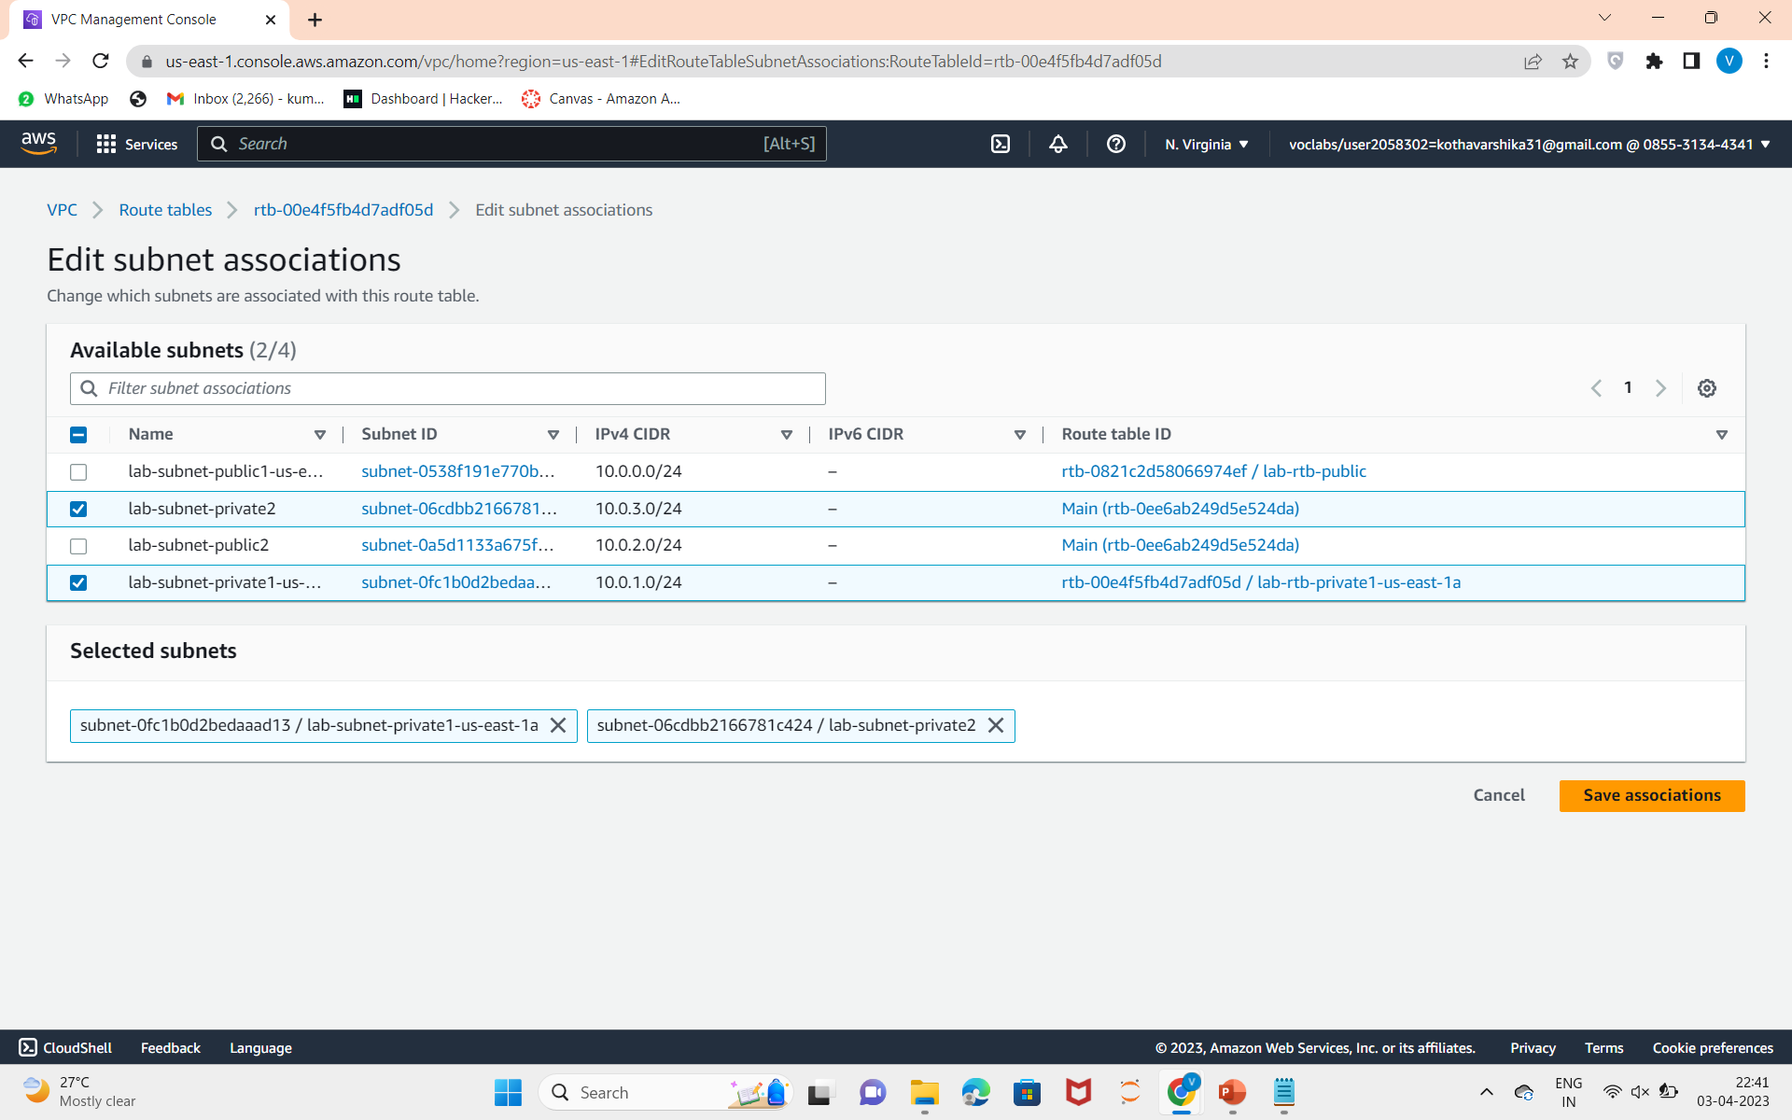
12.Click on edit subnet associations andChoose save associations.

Slide 12
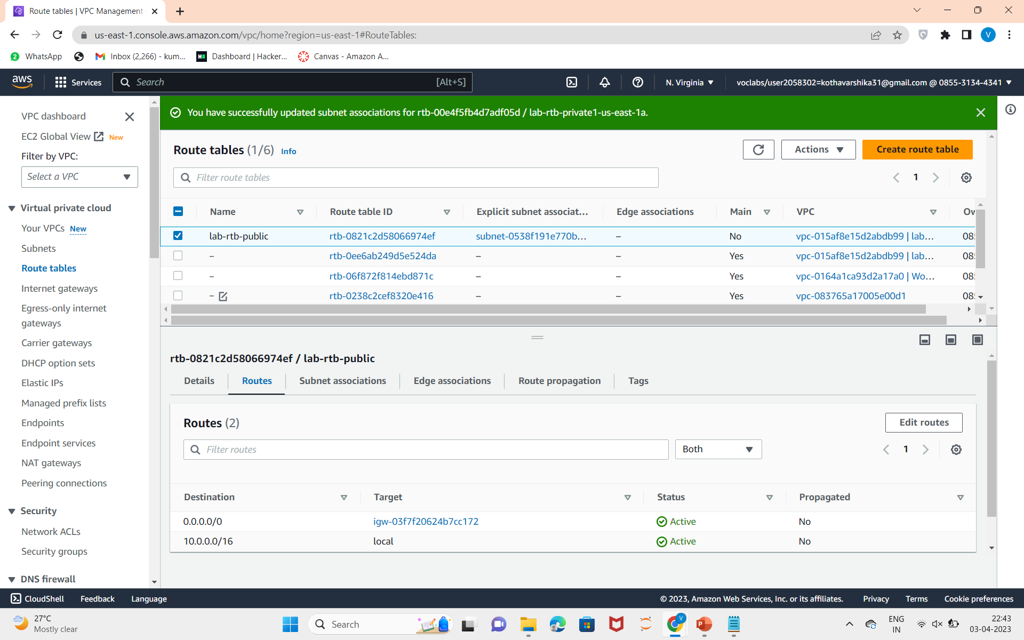
13.Click on lab-rtb-public in route tables,and select route and check destination and target.

Slide 13
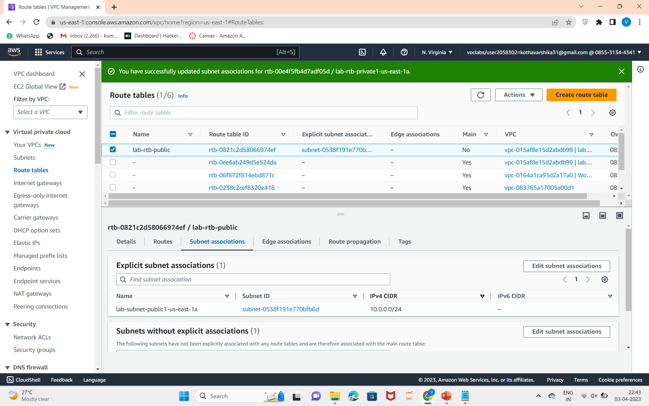
14.Choose Subnet associations.

Slide 14
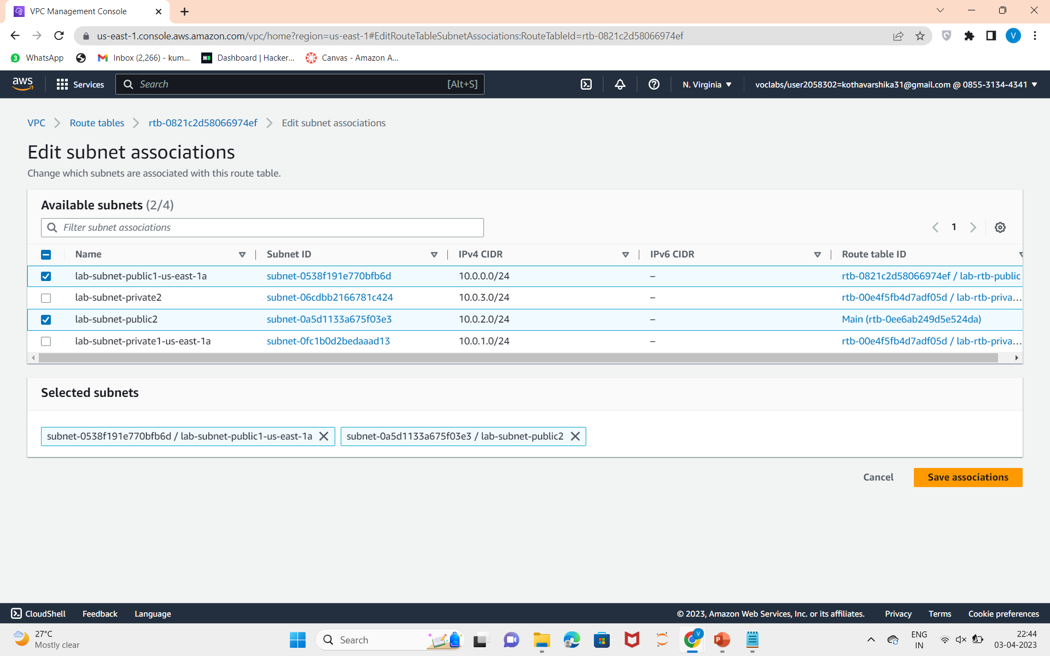
15.Edit Subnet associations and save associations.

Slide 15
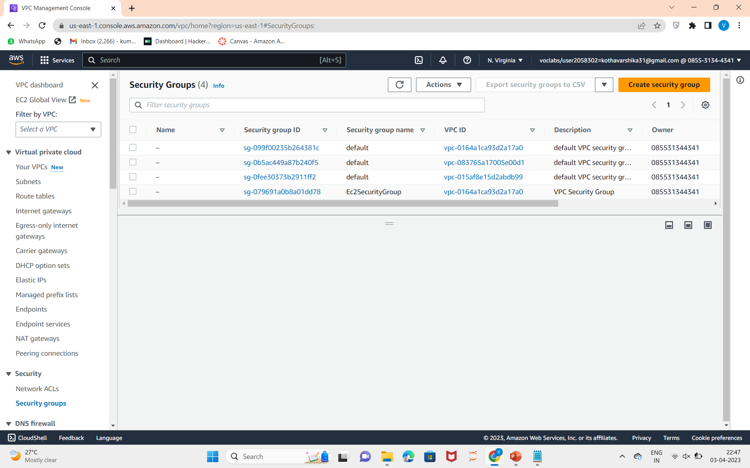
Create a VPC Security Group
16.Select security groups from the left panel,choose create security group

Slide 16
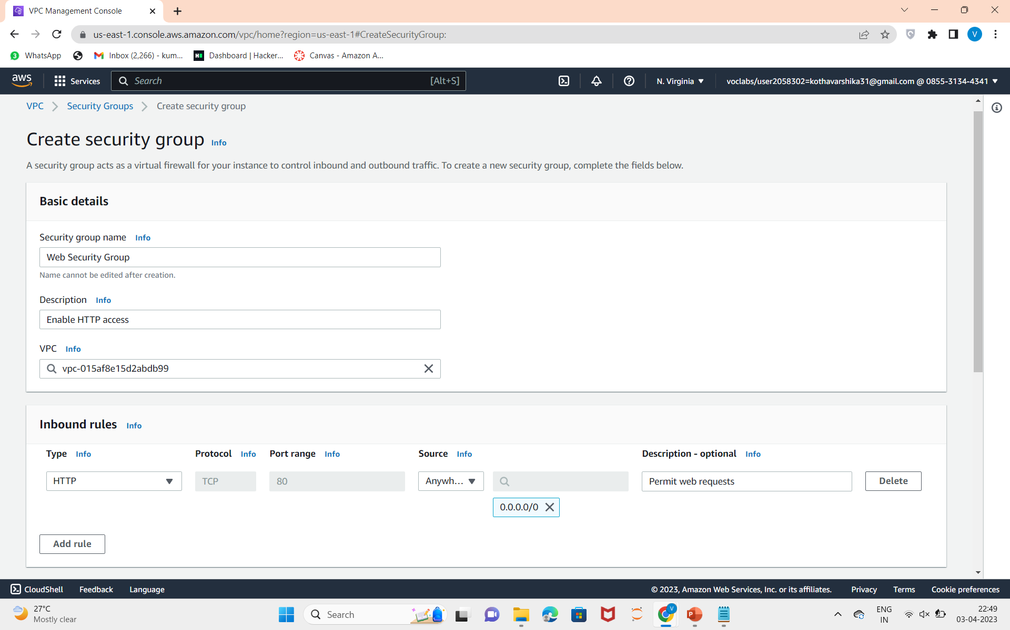
17.Create a security group

Slide 17
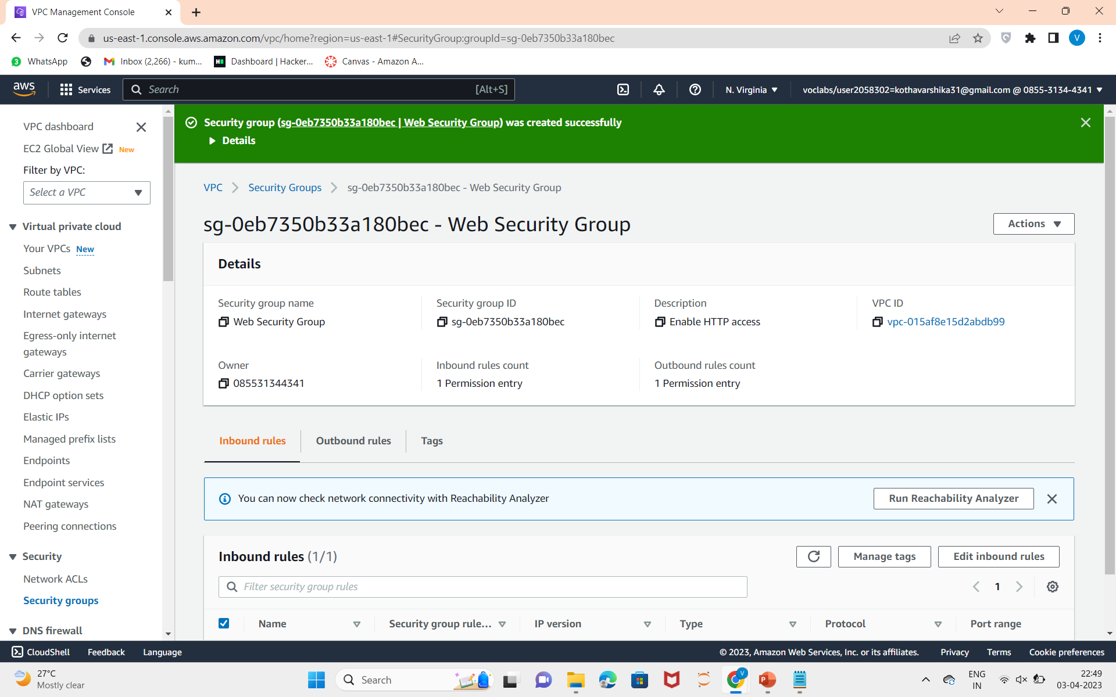
18.security group is created.

Slide 18
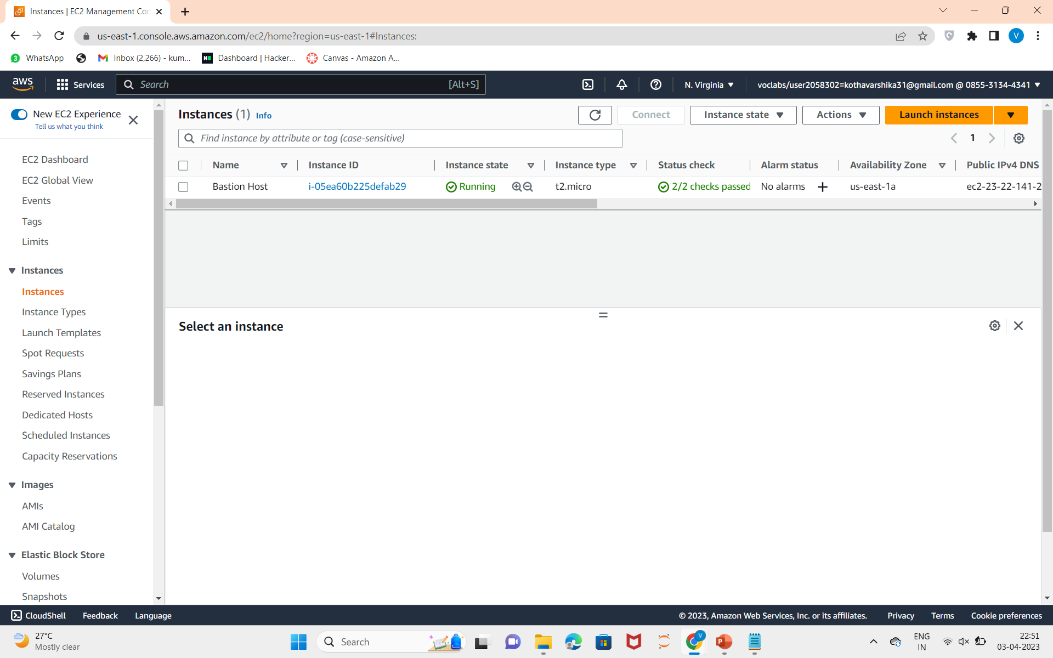
Launch a Web Server
19.IN services choose EC2 instances and choose create instance

Slide 19
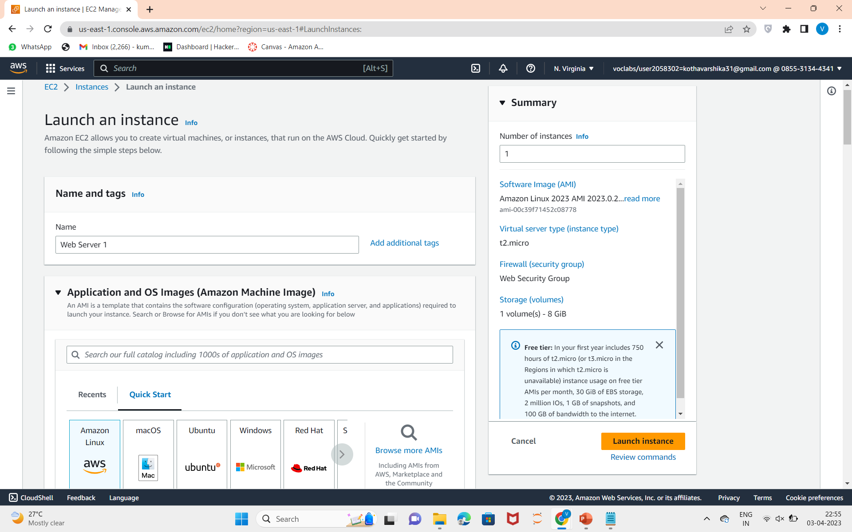
20.Launch an instance.

Slide 20
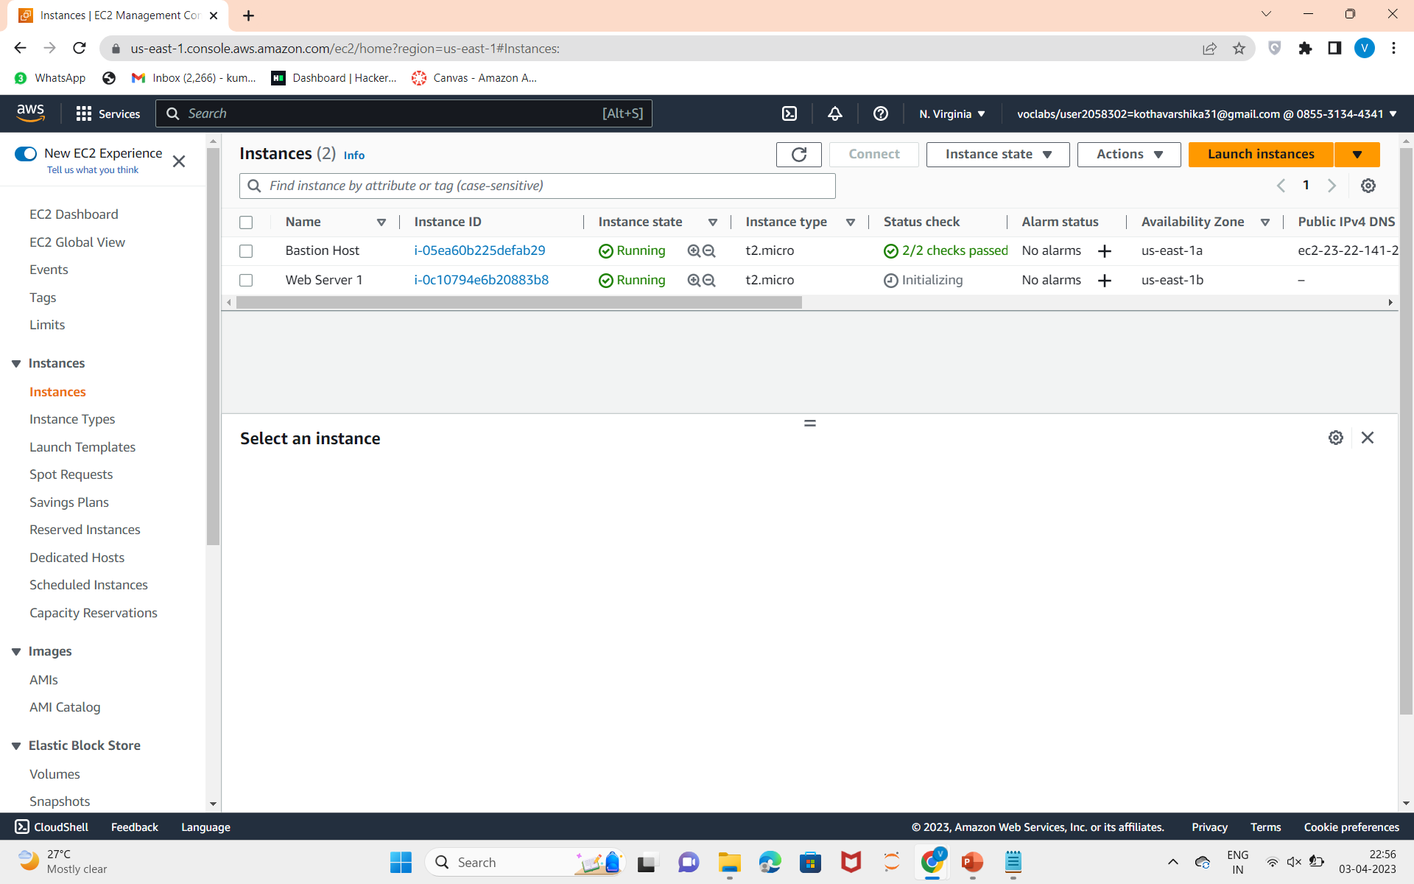
21.Click on view all instances and select the public IPv4 DNS and paste on the other browser.

Slide 21
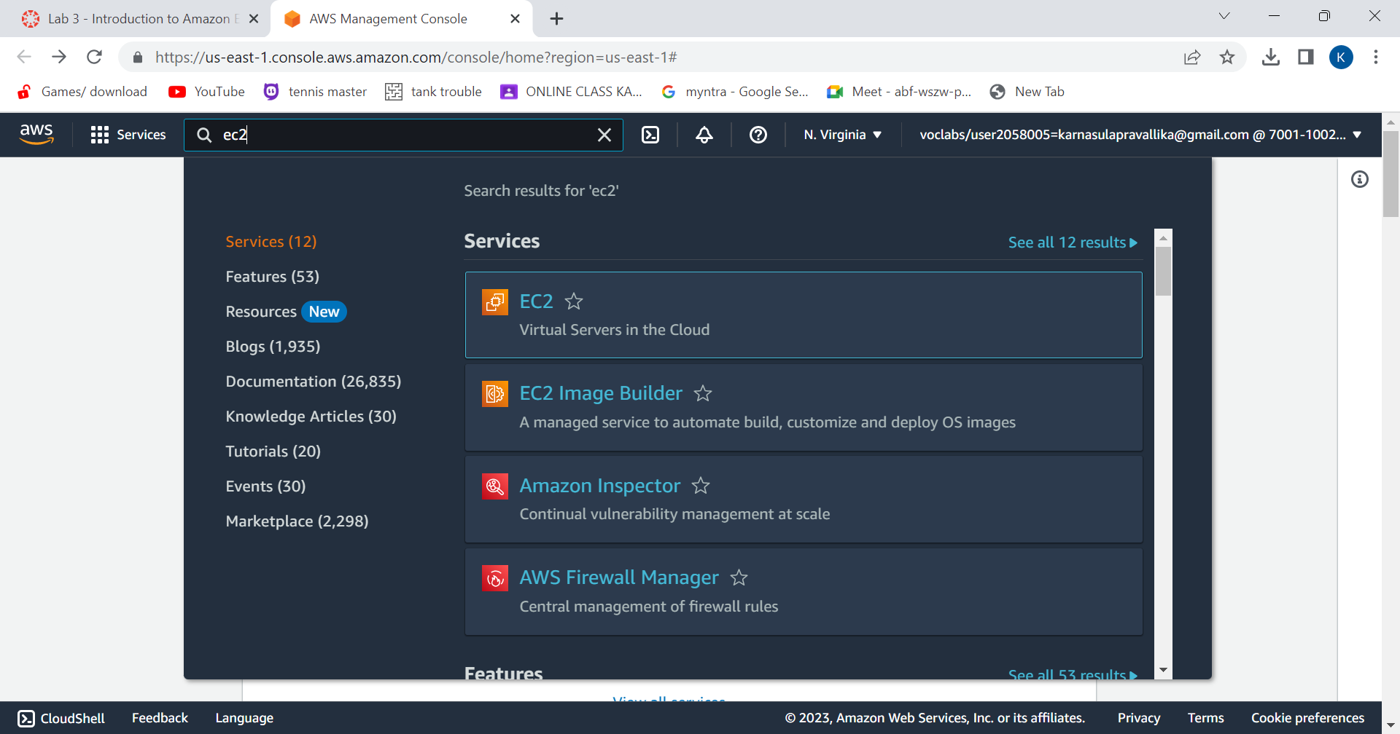
Amazon EC2
1.Click on services and choose EC2.

Slide 22
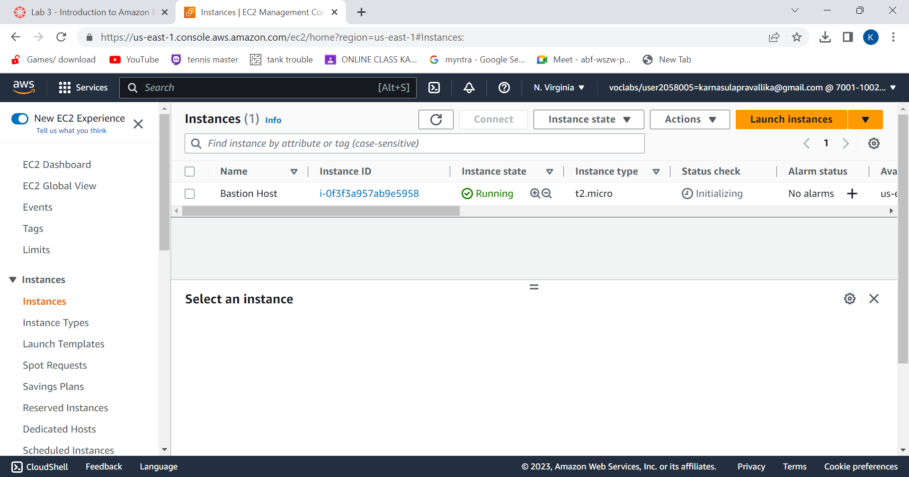
Application and OS Images (Amazon Machine Image):
2.Then click on instances and then click on launch instances.

Slide 23
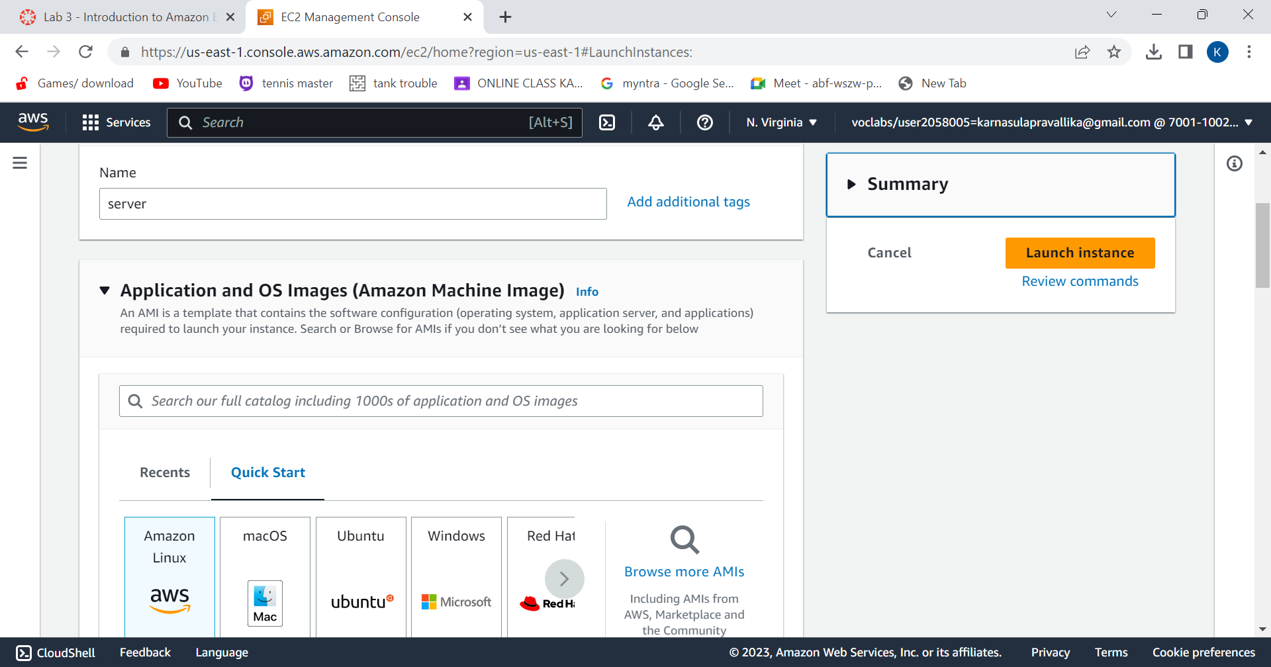
3.Give name to your instance.
Choose AMI. Here, I selected Amazon Unix

Slide 24
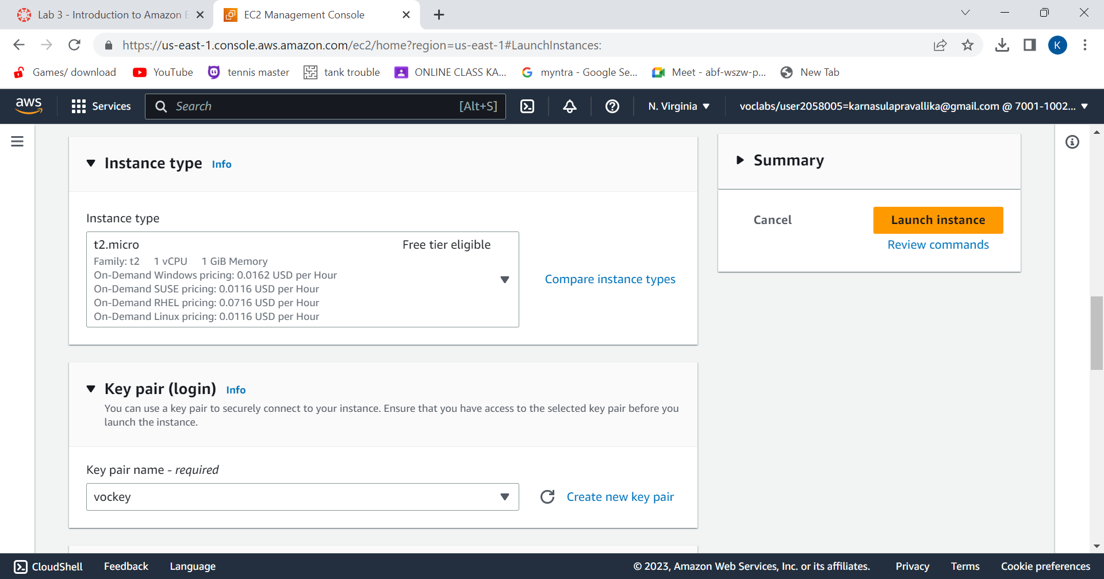
4.Choose instance type t2.micro and key pair.

Slide 25
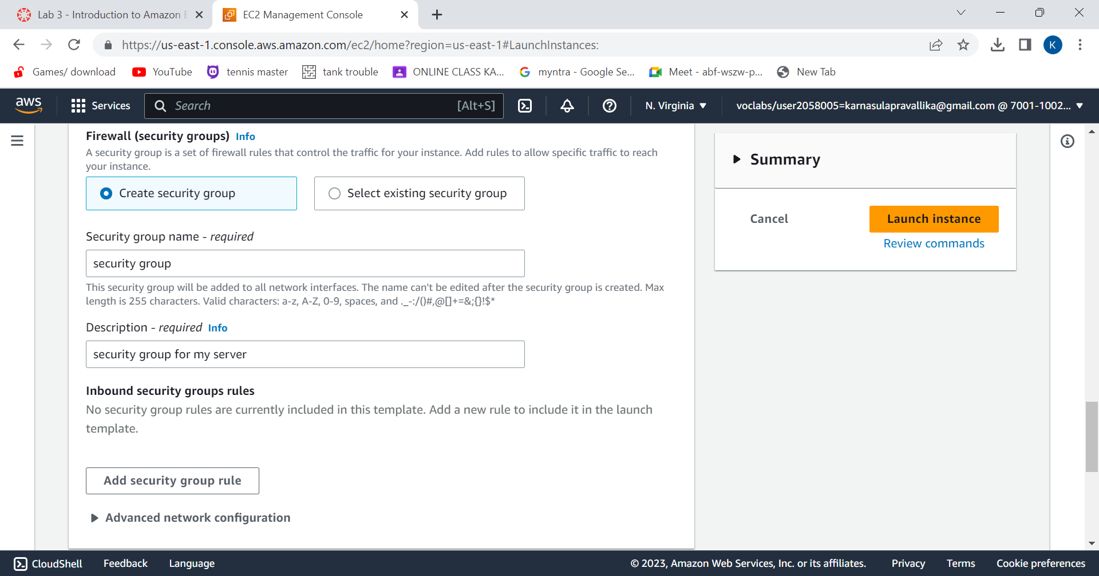
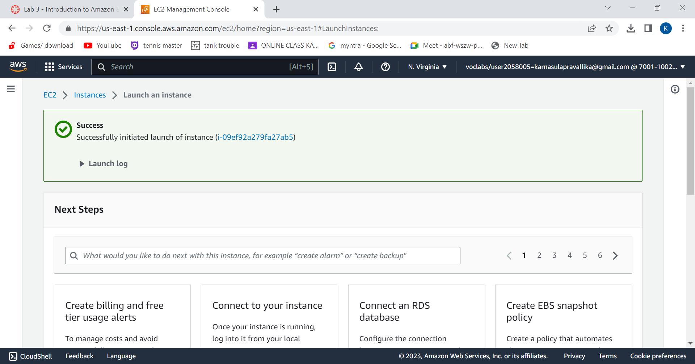
5.Configure security groups and remove inbound security groups if any . Enable Termination Protection. Click on Launch instance.
6.Instance will be created.

Slide 26
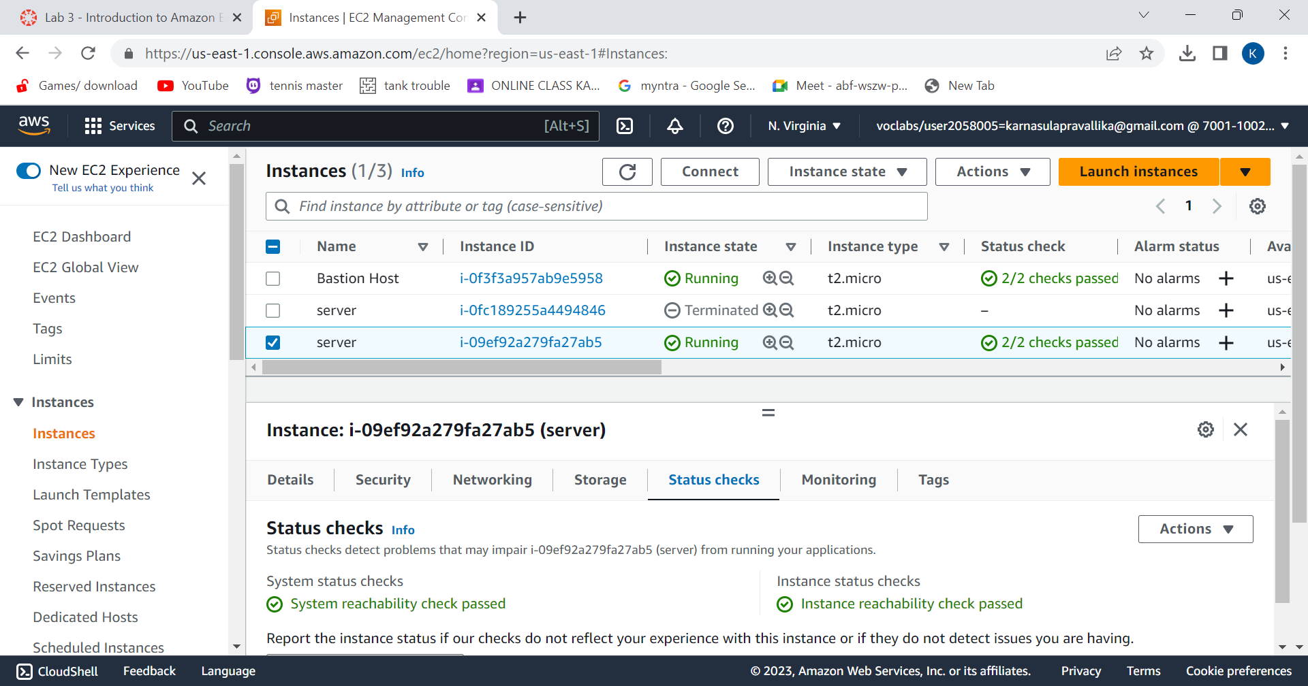
7.Wait for your instance to display the following:
Instance State: Running
Status Checks: 2/2 checks passed
successfully launched the first Amazon EC2 instance.

Slide 27
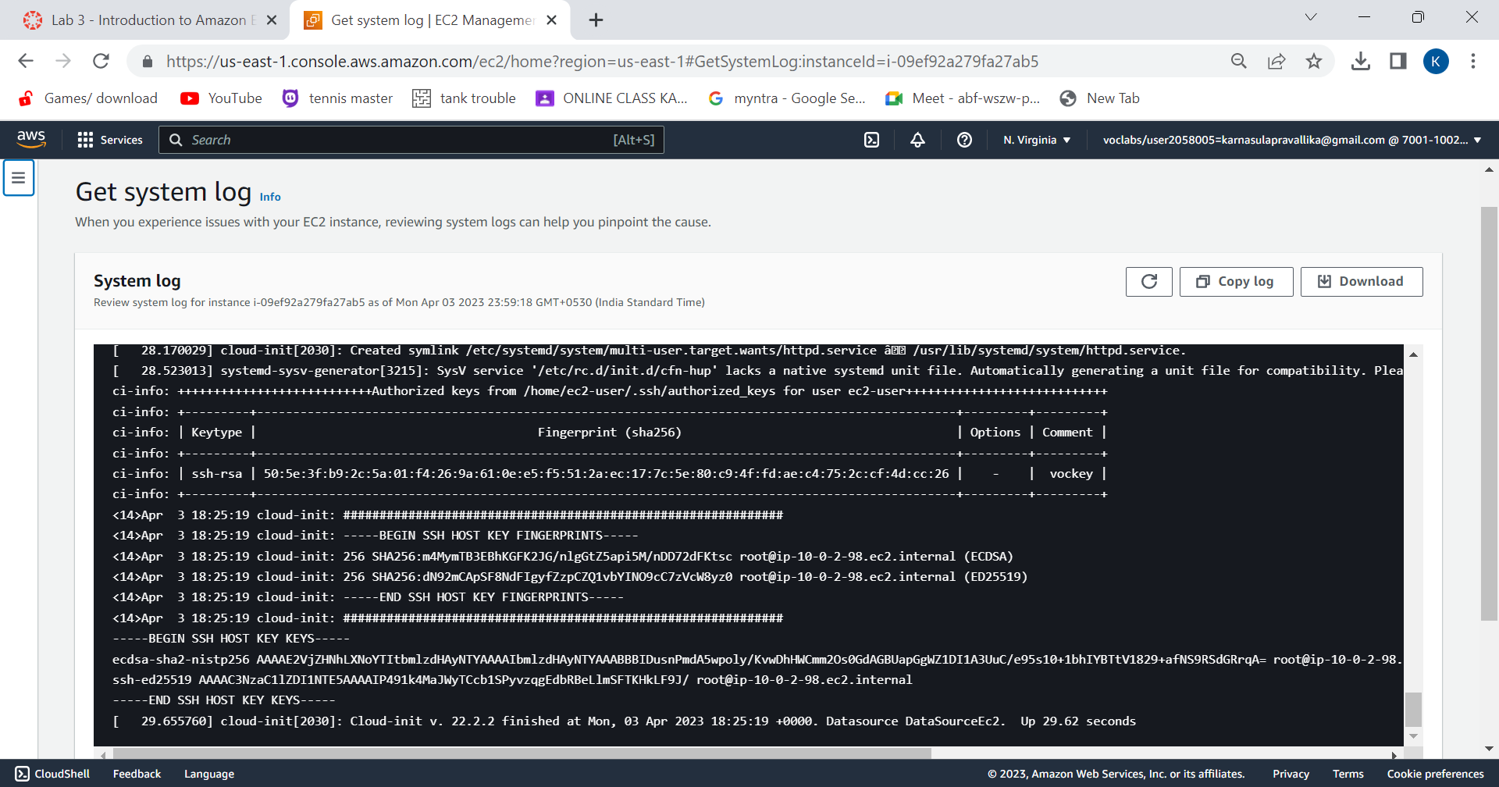
Monitoring the instance: 8.choose monitoring in details tab.
You have explored several ways to monitor your instance.

Slide 28
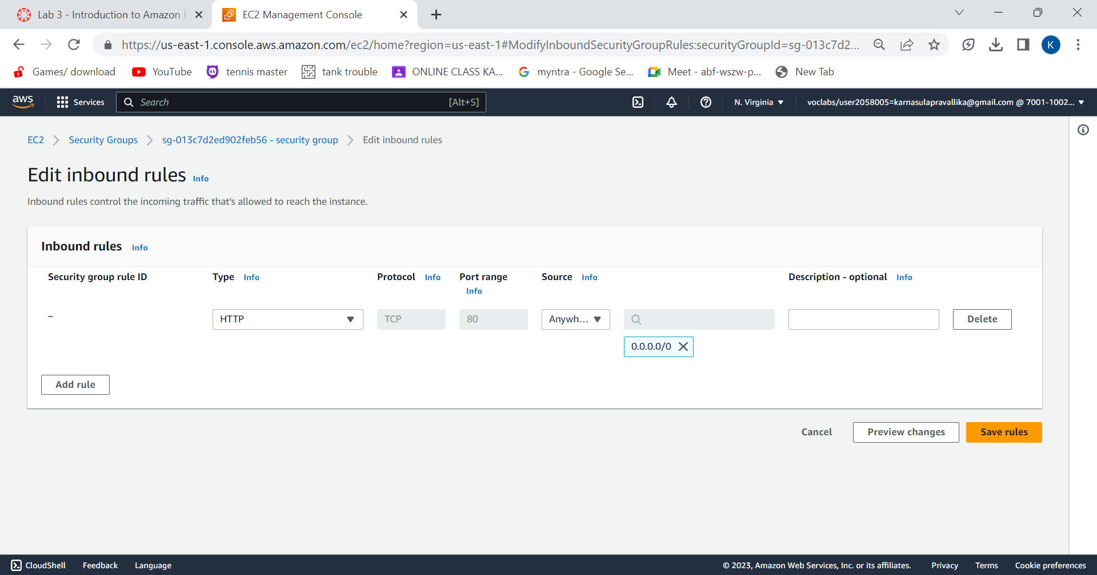
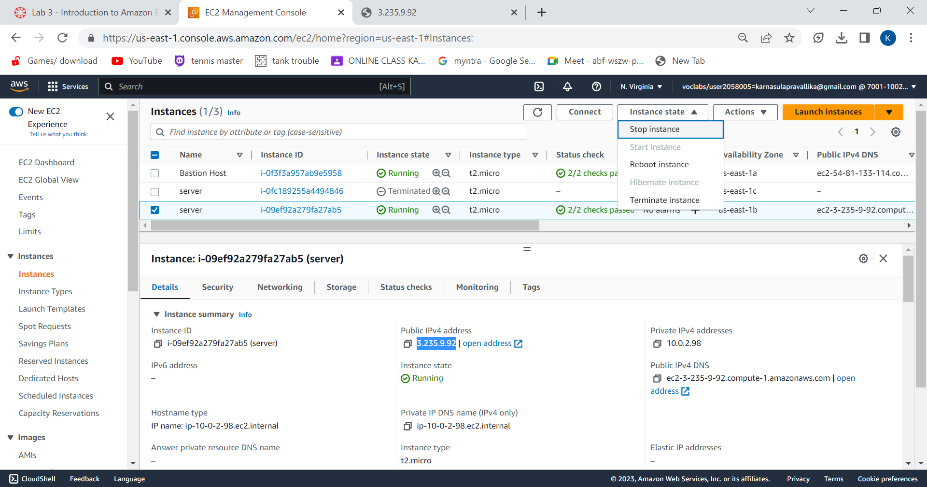
Update security group and access the server:
9.Ensure Web Server is still selected. Choose the Details tab. Copy the Public IPv4 address of your instance to your clipboard.
Open a new tab in your web browser, paste the IP address you just copied, then press Enter.
Choose Edit inbound rules, select Add rule and then configure:
Type: HTTP
Source: Anywhere-IPv4
Choose Save rules

Slide 29
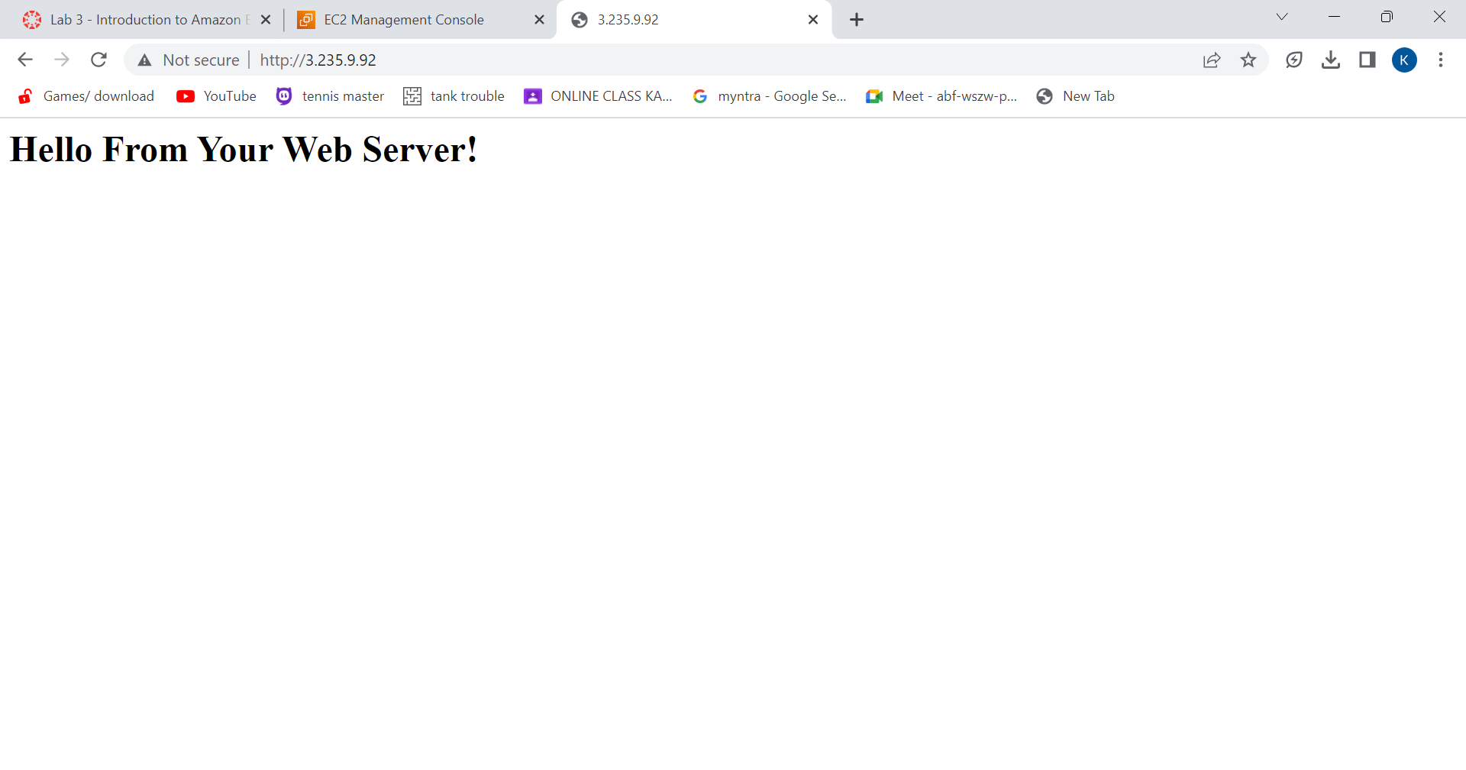
10.Return to the web server tab that you previously opened and refresh the page.
You should see the message Hello From Your Web Server!
You have successfully modified your security group to permit HTTP traffic into your Amazon EC2 Instance.

Slide 30
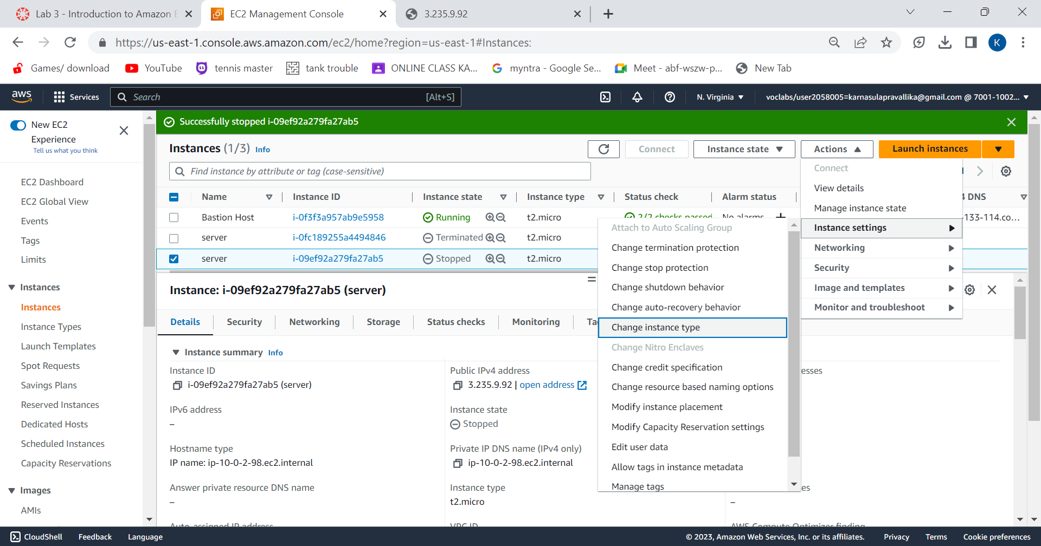
Resize the instance:
11.First, stop the instance.
12.Instance will be stopped.
13.Change instance type from t2.micro to t2.small.

Slide 31
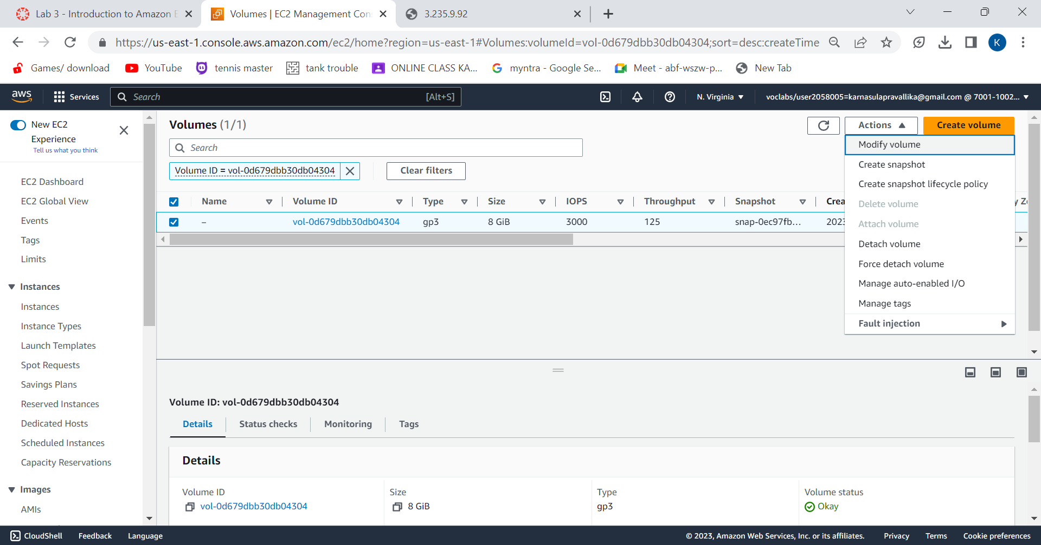
Resize the EBS volume: 14.At instance, choose Storage and select volume ID. Then select the checkbox next to volume that displays. In the actions menu, select Modify Volume.

Slide 32
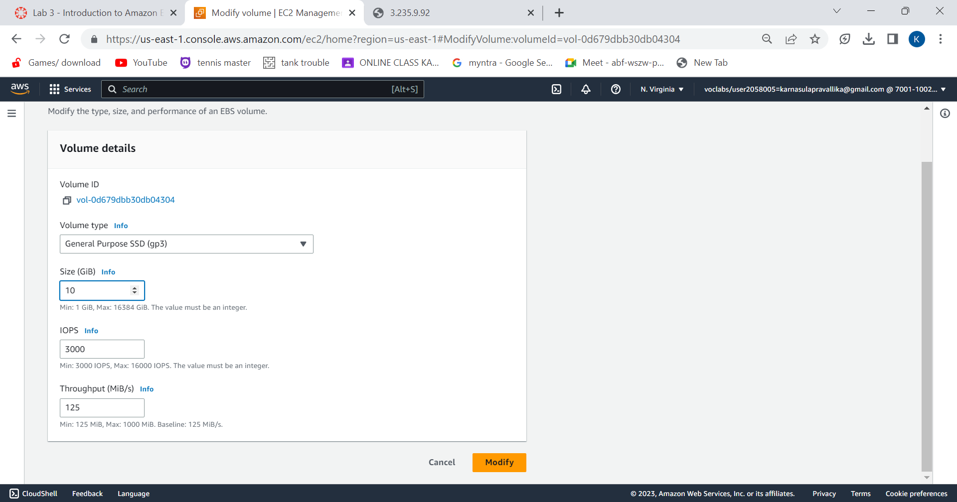
15.Change the size to 10 GiB and click modify.

Slide 33
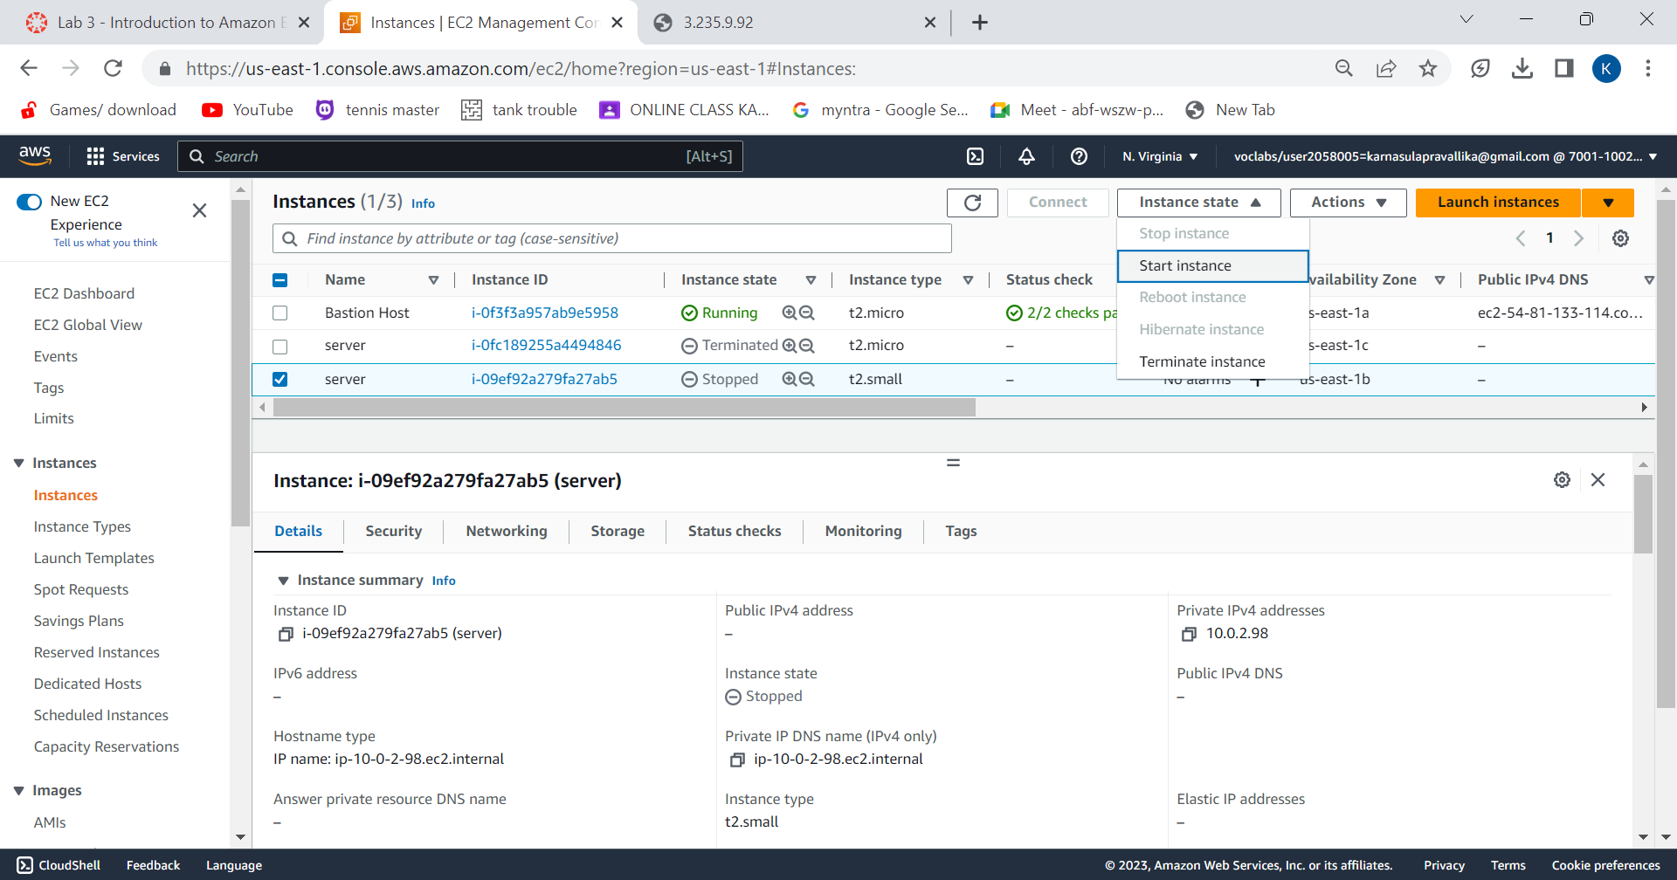
16.Now, start the instance.

Slide 34
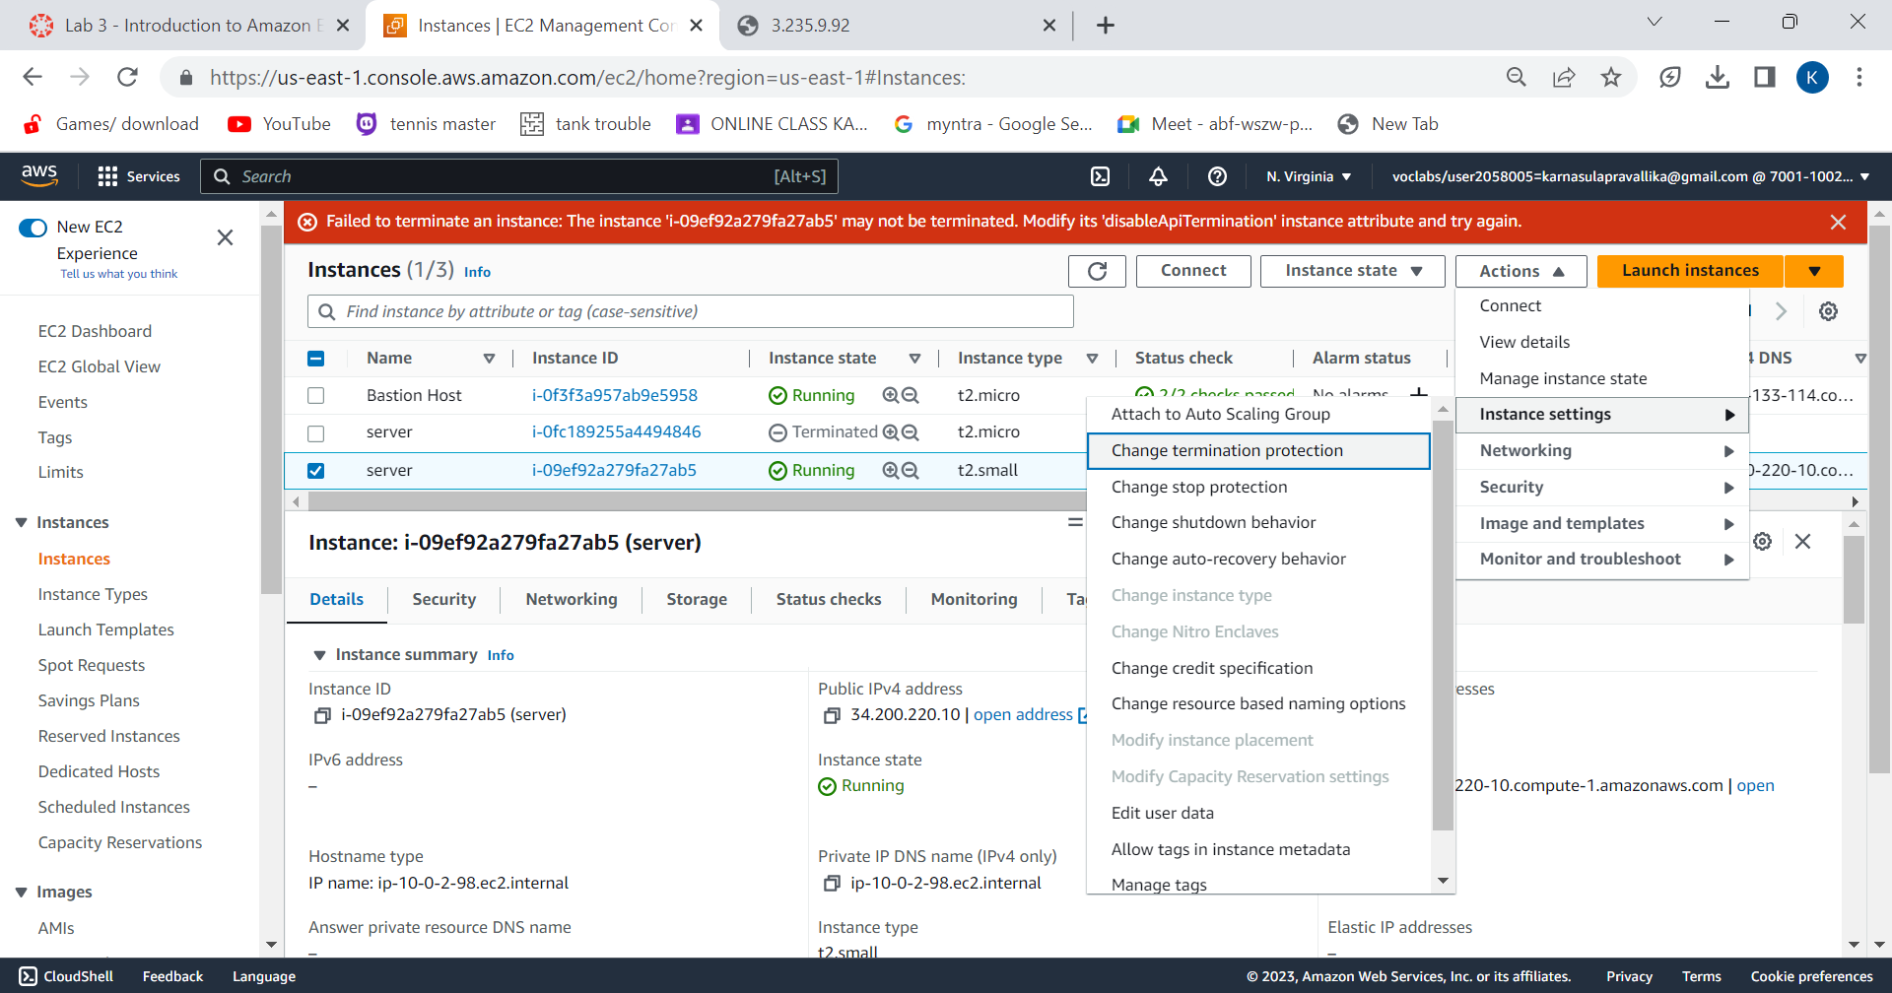
Testing Termination Protection:
17.Terminate the instance.
You will notice an error during termination.
Then click on actions menu, select instance settings.
Click on change termination protection.Deselect enable.

Slide 35
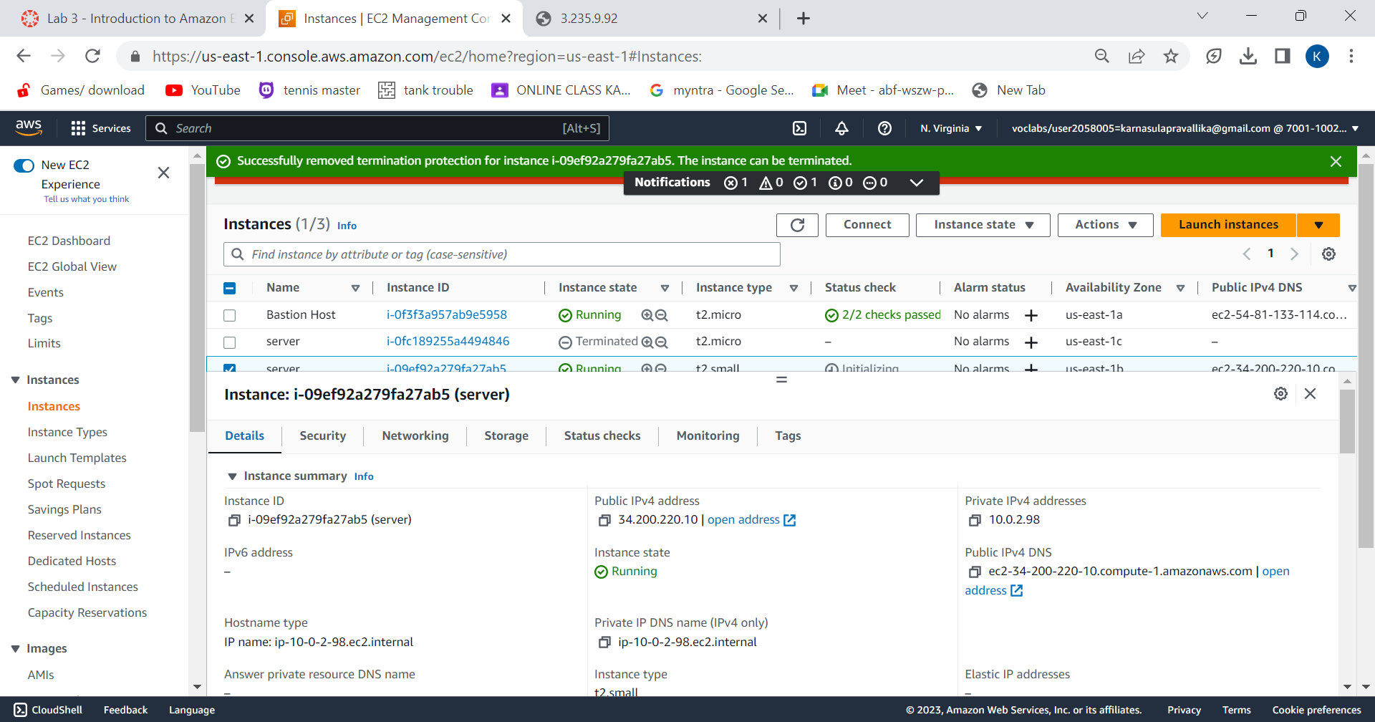
18.Successfully removed termination protection.

Slide 36
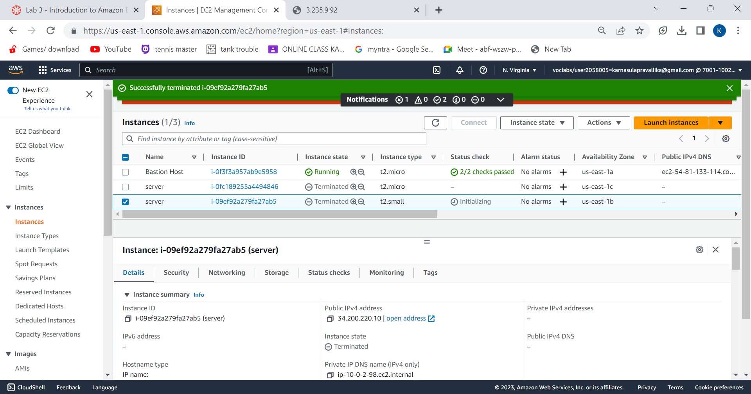
19.Finally, Terminate the instance.
Successfully tested termination protection and terminated the instance.

Slide 37
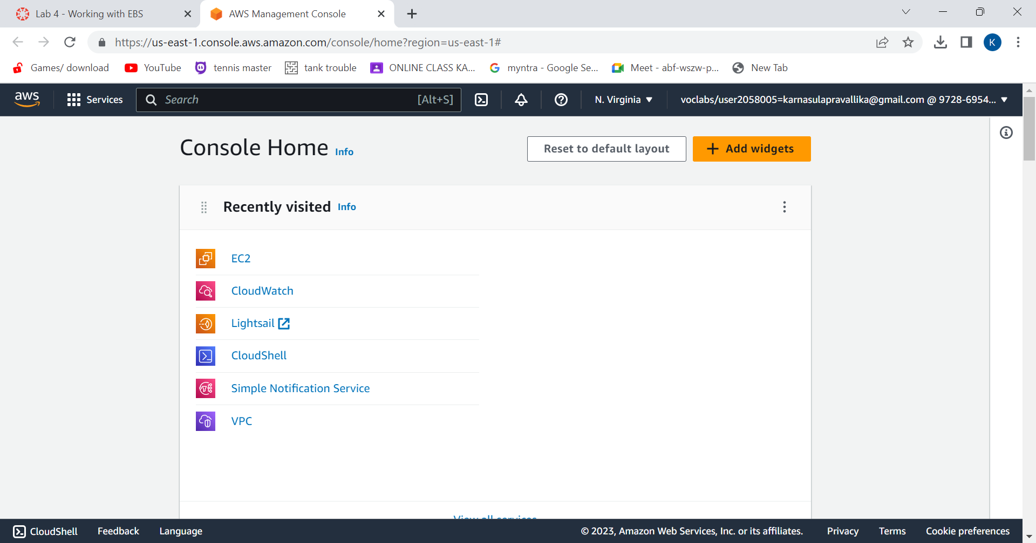
Amazon EBS Create a New EBS Volume
On “Services” menu, click EC2.

Slide 38
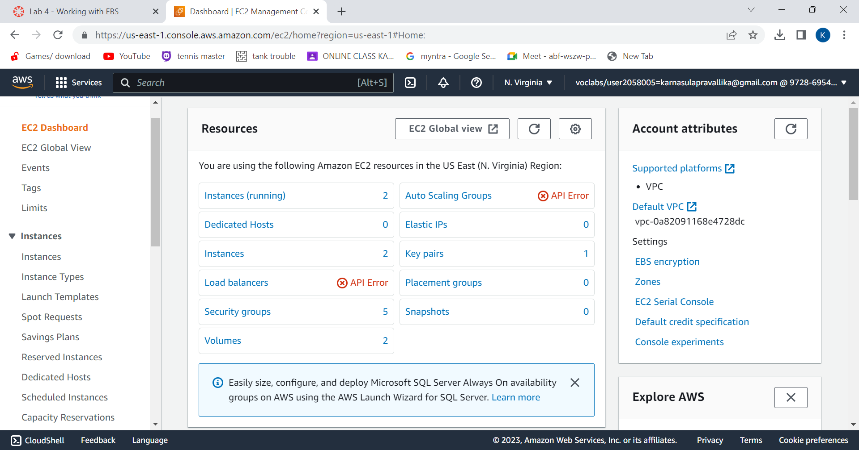
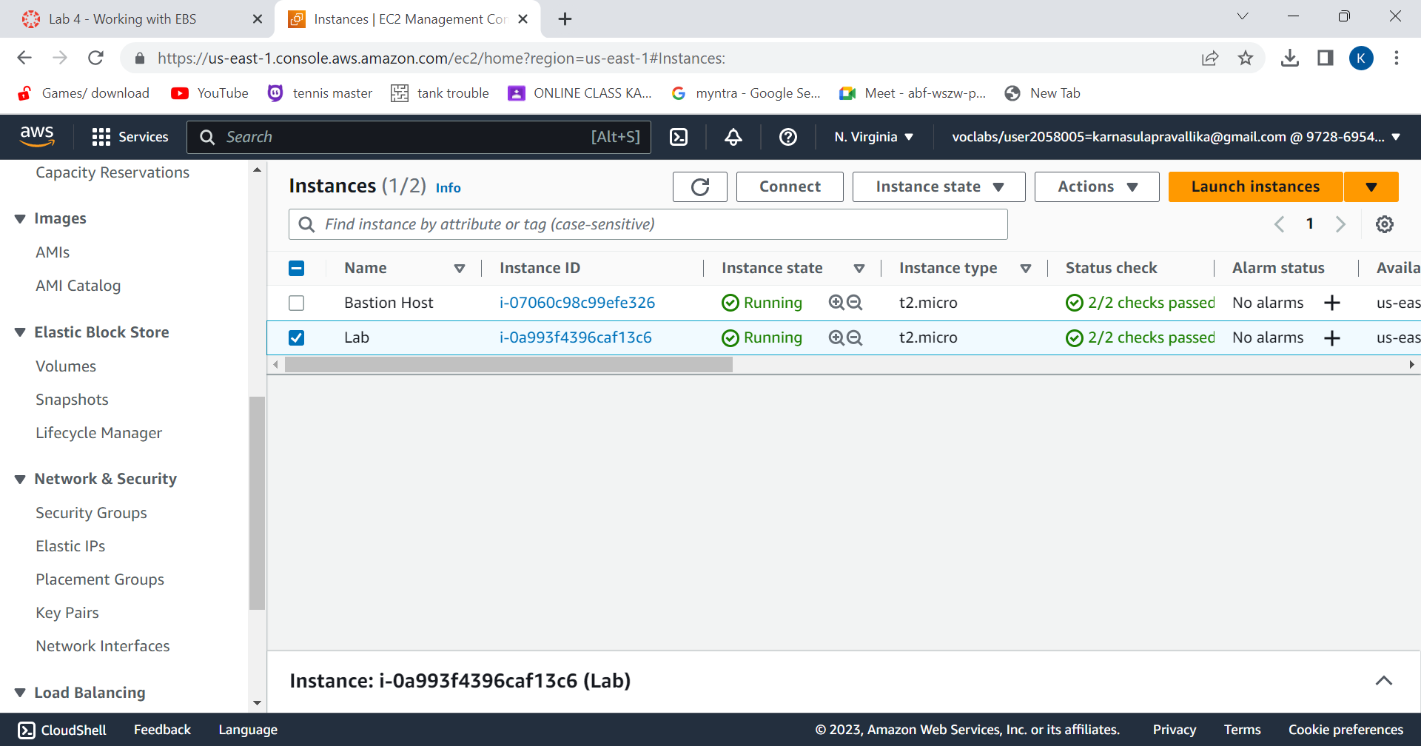
choose instances.
Lab has already been launched.

Slide 39
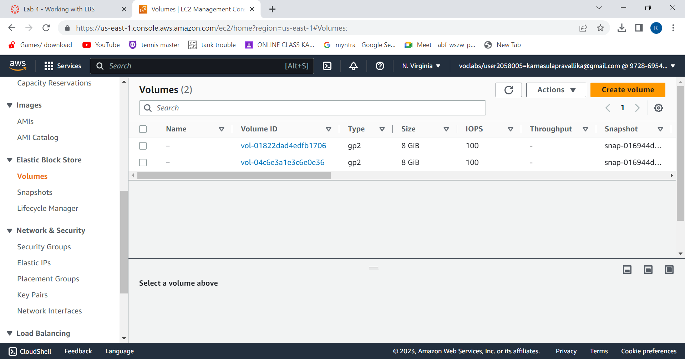
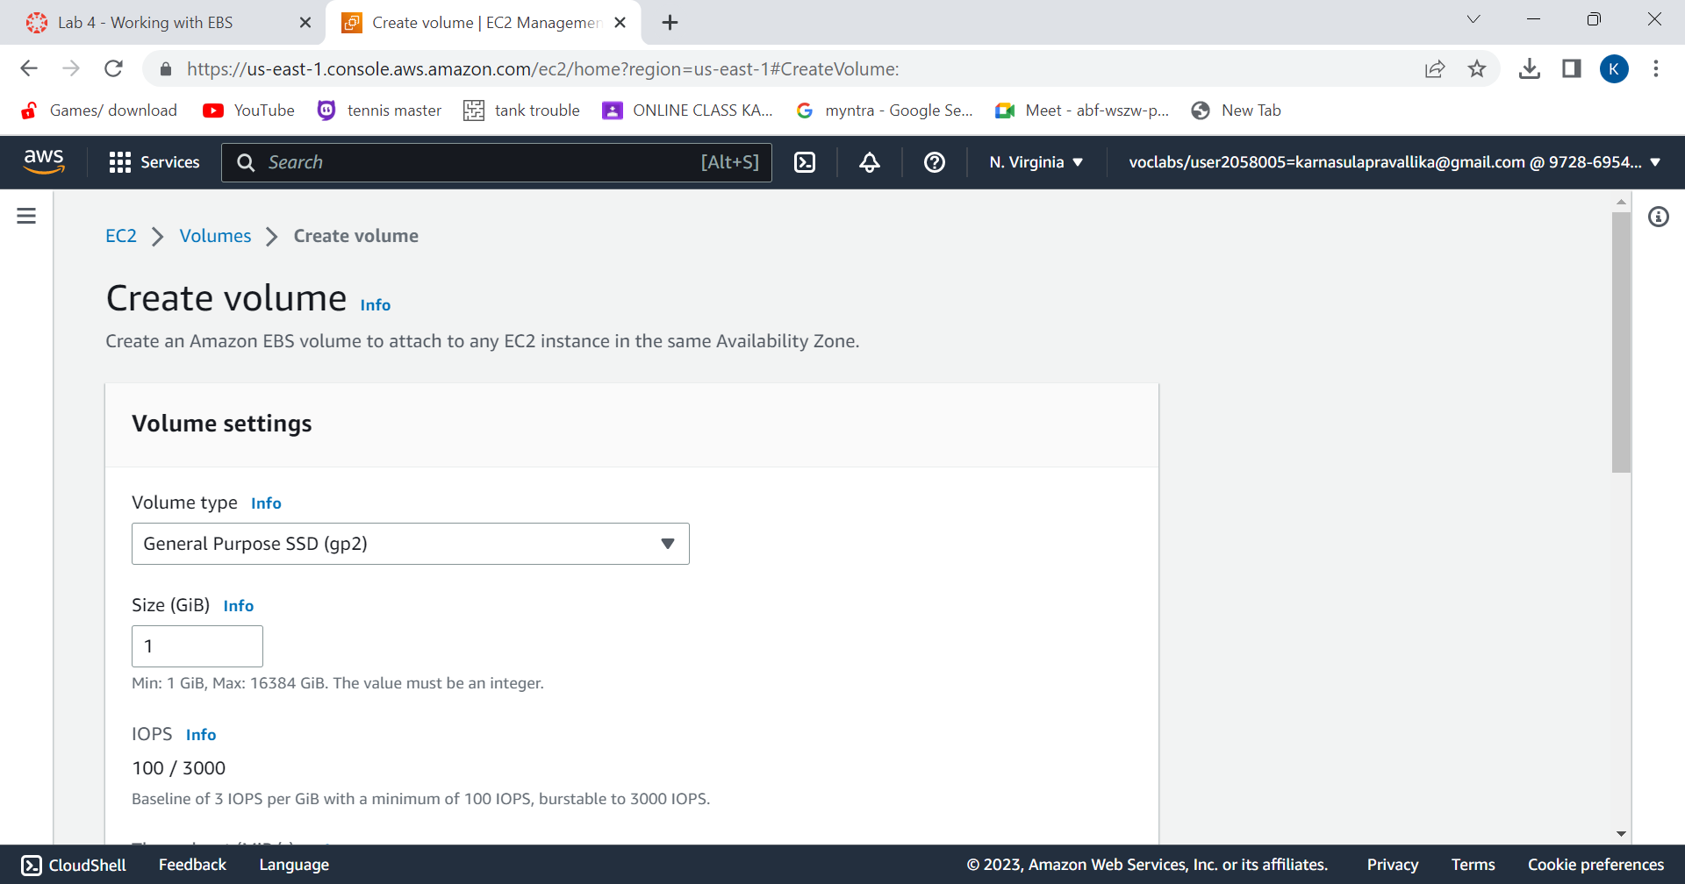
choose Volumes. Then choose “Create Volume”.
Configure the volume settings.

Slide 40
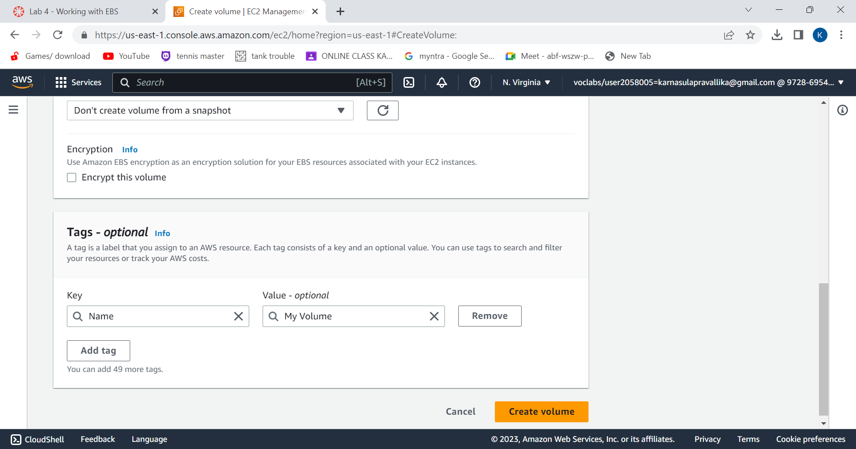
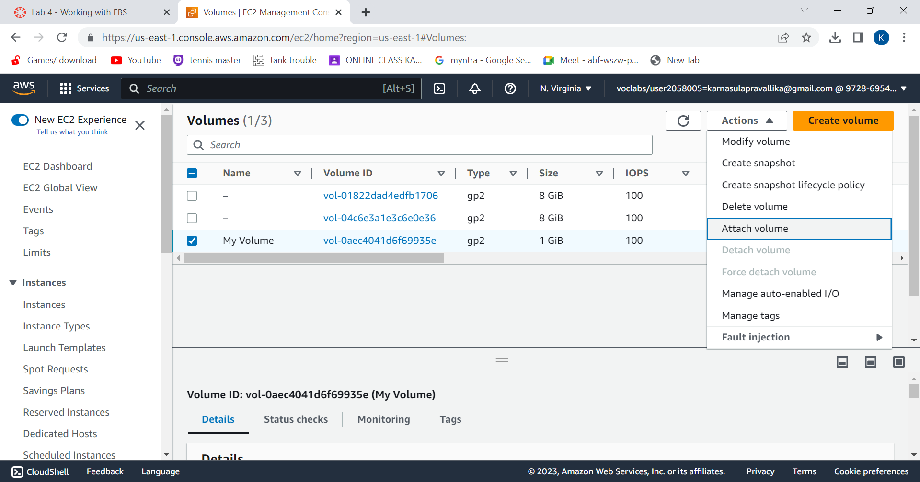
Add tag and choose “create volume”.
Volume is created. Select “My Volume” and in the Actions menu,choose “Attach Volume”.

Slide 41
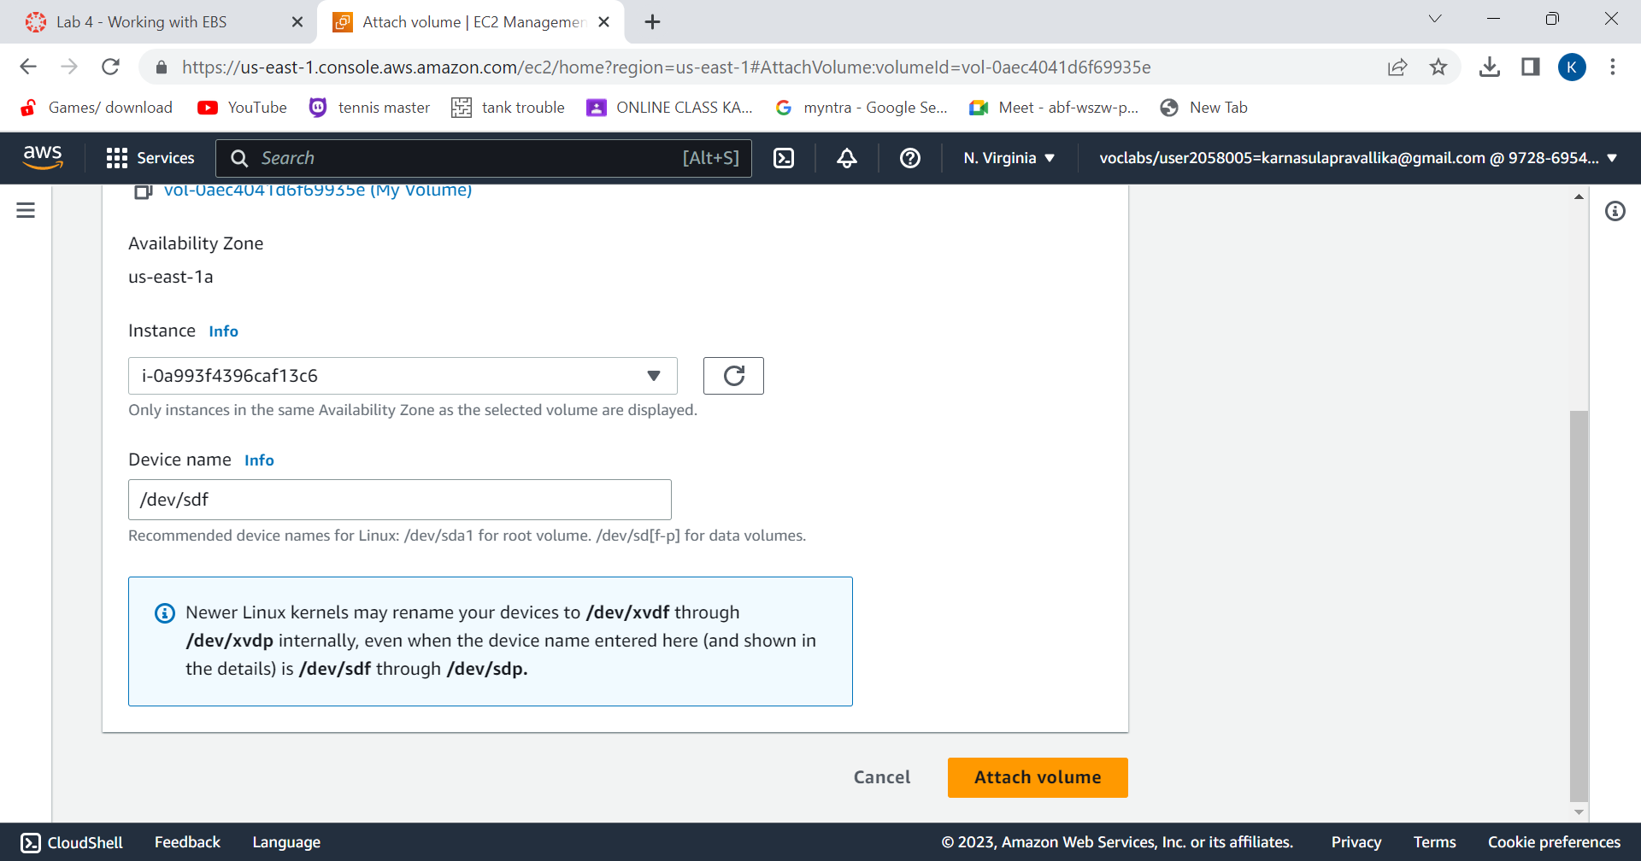
Choose the Instance field and choose “Attach Volume”.
Then the volume will be in use.

Slide 42
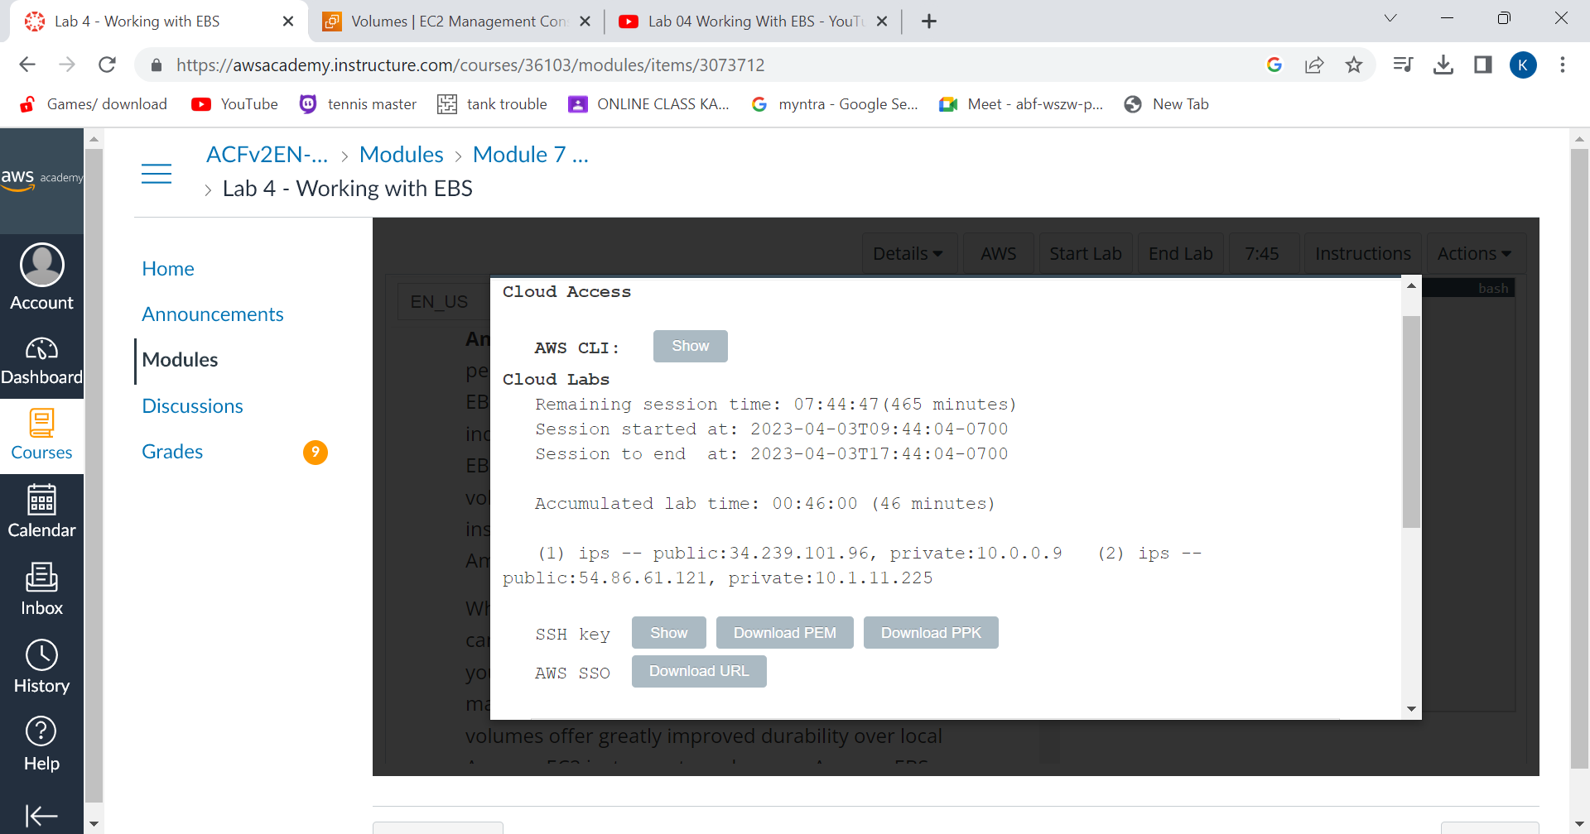
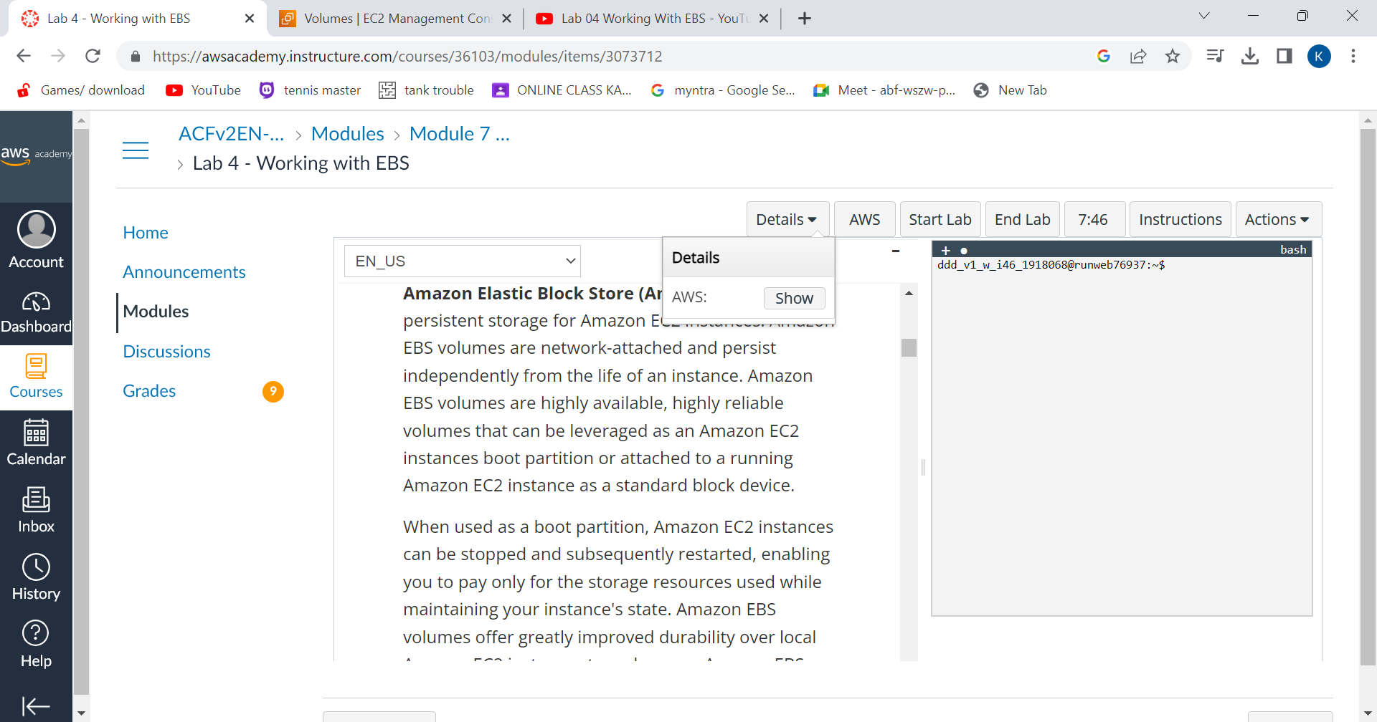
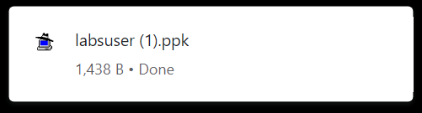
Redirecting to instructions panel, choose Details and click on Show.
Credentials window will open and choose Download PPK button and
save the labuser.ppk file.

Slide 43
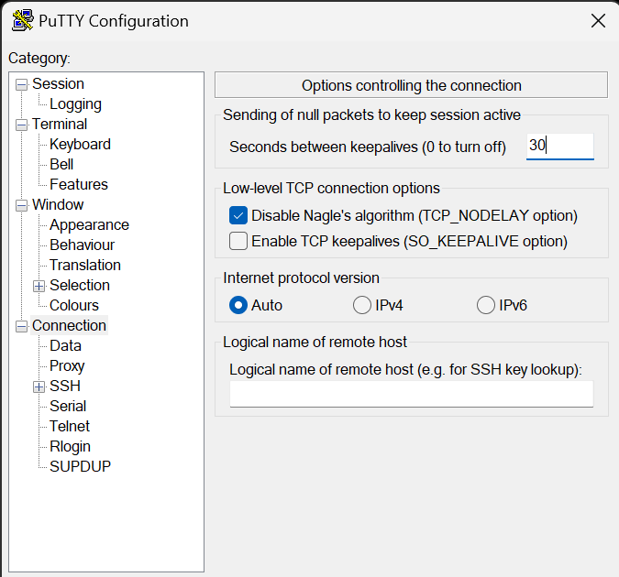
Now, You will use PuTTY to SSH to Amazon EC2 instances.
Open putty.exe and configure like below:
Choose Connection.
Set Seconds between keepalives to 30.
Choose Session
Host Name (or IP address): Paste the Public DNS or IPv4 address of the Lab instance that you noted earlier.
Back in PuTTY, in the Connection list, expand SSH
Choose Auth and expand Credentials
Under Private key file for authentication: Choose Browse
Browse to the labsuser.ppk file that you downloaded, select it, and choose Open
Choose Open again.
To trust and connect to the host, choose Accept.
When prompted login as, enter: ec2-user

Slide 44
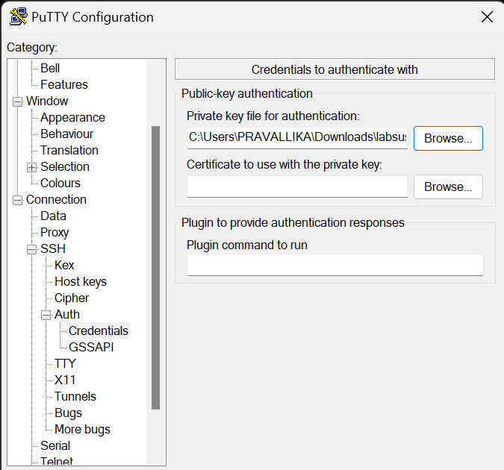


Slide 45



create and configure your file system.
In PuTTY, by executing certain commands, you will
View the storage available on your instance.
Create an ext3 file system on the new volume.
Create a directory for mounting the new storage volume.
Mount the new volume.
View the configuration file to see the setting on the last line.
create a file and add some text to it.
Verify that the text has been written to your volume.

Slide 46


Create an Amazon EBS Snapshot.
.create Volume from Snapshot.

Slide 47


Attach restored volume to your EC2 instance:
choose volumes and select restored volume.
in the Actions menu, select Attach volume.

Slide 48
Mount the restored volume.
Finally, You should see file.txt.

Slide 49

Relational Database Service(RDS)
1. In the AWS Management Console, on the Services menu, choose VPC.

Slide 50

2.In the left panel,choose security groups

Slide 51


3.After choose create security groups .
4.Give name ,descrption,VPC to the security group.
5.Add an Inbound rule also.
6.Click on create security group

Slide 52

7.Security group is created.

Slide 53

Create a DB subnet Group
8.ON services menu ,choose RDS

Slide 54

9.On left navigation panel,choose subnet groups.

Slide 55


10.Choose create DB subnet group and then configure

Slide 56

11.Subnet is created.

Slide 57
Create an amazon RDS DB Instance
12.Launching Multi-AZ Amazon RDS for MySQL database instance.
13.In the left panel,choose Databases

Slide 58


14.Choose create Database.
15.Create database by choosingMySQL
16.Under settings configure DB instance identifier, Master usernameand giving password

Slide 59


15.Under DB Instance class,configure Burstable classes(includes t classes) and db.t3.micro
16.And also configure storage,connectivity,additional configuration
17.Chosse create database

Slide 60

18.Database is created

Slide 61
19.Choose lab-db,after the info changes to modifiying or avaliable,
20.Scroll down to connectivity and security copy the endpoint.

Slide 62

Interact with Database
21.Above the lab instructions ,choose details dropdown and then choose show.
22.Copy the IP address of the Webserver.

Slide 63


23.Open a new browser and paste the IP address of webserver.
24.Click on RDS on the top of the page.
25.Fill endpoint of lab-db, database, username and password

Slide 64

26.Address Book will be displayed.

Slide 65

AWS IAM
LAB 1: INTRODUCTION TO AWS IAM
Explore the Users and Group
1.In the AWS Management Console, on the Services menu, select IAM.
2.In the navigation pane on the left, choose Users.
3.Create the user with the following name.
user-1
4.Click Next and click Create user

Slide 66

Notice that user-1 does not have any permissions.
5. Choose the Groups tab.
user-1 also is not a member of any groups.
6. Choose the Security credentials tab.
user-1 is assigned a Console password
7. In the navigation pane on the left, choose User groups.
Choose the EC2-ReadOnlyAccess group.
This will bring you to the summary page for the EC2-Support group.
8.Choose the Permissions tab.
This group has a Managed Policy associated with it, called AmazonEC2ReadOnlyAccess. Managed Policies are pre-built policies (built either by AWS or by your administrators) that can be attached to IAM Users and Groups. When the policy is updated, the changes to the policy are immediately apply against all Users and Groups that are attached to the policy.

Slide 67


Add Users to Groups
Add user-1 to the EC2-ReadOnlyAccess
1.In the left navigation pane, choose User groups.
2. Choose the EC2-ReadOnlyAccess group.
3. Choose the Users tab.
4.In the Users tab, choose Add users.

Slide 68

Sign-In and Test Users
1. Paste the IAM users sign-in link into the address bar of your private browser session and press Enter.
Next, you will sign-in as user-1, who has been hired as your Amazon S3 storage support staff.
2. Sign-in with:
IAM user name: user-1
Password: Lab-Password1
3.Click sign in
4. Set New Password.

Slide 69


4.In the Services menu, choose EC2.
5. In the navigation pane on the left, choose Instances.
6.In the Instance state menu above, select Stop instance.
7. Choose Sign Out

Slide 70

Scale and Load Balance Your Architecture
Create an AMI for Auto Scaling
1.In the AWS Management Console, on the services menu, click EC2.
2. In the left navigation pane, click Instances.
3. First, you will confirm that the instance is running. Wait until the Status Checks for Web Server 1 displays 2/2 checks passed. Click refresh to update.
Select Web Server 1
4. In the Actions menu, click Image and templates > Create image, then configure:
Image name: WebServerAMI
Image description: Lab AMI for Web Server

Slide 71


5. Click Create Image
Create a Load Balancer
1.In the left navigation pane, choose Target Groups.
Choose Create Target Group
Choose a target type: Instances
Target group name, enter: LabGroup
Select Lab VPC from the VPC drop-down menu.
2. Choose Next. The Register targets screen appears.

Slide 72


3. Review the settings and choose create target group.

Slide 73

4. In the left navigation pane, click Load Balancers.
5. At the top of the screen, choose create Load Balancer.
6. Under Application Load Balancer, choose Create
7. Under Load balancer name, enter: LabELB
8. Scroll down to the Network mapping section, then:
For VPC, select: Lab VPC
9. Choose the first displayed Availability Zone, then select Public Subnet 1, for Second Availability Zone select Public Subnet 2.

Slide 74


10. In the Security groups section: Select Web Security Group
11. For the Listener HTTP:80 row, set the Default action to forward to LabGroup.

Slide 75

12. In the Additional settings - optional pane, select Enable group metrics collection within CloudWatch
13.Choose Next.
14.Under Group size, configure:
Desired capacity: 2
Minimum capacity: 2
Maximum capacity: 6
15. Under Scaling policies, choose Target tracking scaling policy and configure:
Lab policy name: LabScalingPolicy
Metric type: Average CPU Utilization
Target value: 60

Slide 76


16. Choose Next
17.Choose Next
18. Choose Tag
Key: Name
Value: Lab Instance

Slide 77

19. Click Next.
20.Review the details of your Auto Scaling group, then click Create Auto scaling Group
Verify that Load Balancing is Working
1. In the left navigation pane, click Instances.(You should see two new instances named Lab Instance.)
2.In the left navigation pane, click Target Groups (in the Load Balancing section).
3. Choose LabGroup
4. Click the Targets tab.(Two Lab Instance targets should be listed for this target group.)
5. Wait until the Status of both instances transitions to healthy
6. In the left navigation pane, click Load Balancers.
7. In the lower pane, copy the DNS name of the load balancer, making sure to omit "(A Record)".

Slide 78


8.Open a new web browser tab, paste the DNS Name you just copied, and press Enter.

Slide 79

Test Auto Scaling
1.
On the services menu, click EC2.
In the left navigation pane, choose Auto Scaling Groups.
Select Lab Auto Scaling Group.
In the bottom half of the page, choose the Automatic Scaling tab.
Select LabScalingPolicy.
Click Actions and Edit.
Change the Target Value to 50.
Click Update.

Slide 80

2. On the Services menu, click CloudWatch.
In the left navigation pane, click All alarms and verify you see two alarms.
3.Click the OK alarm, which has AlarmHigh in its name.
4.Return to the browser tab with the web application.
5. Click Load Test beside the AWS logo.
6. Return to browser tab with the CloudWatch console.
7. Wait until the AlarmHigh alarm enters the In alarm state.
8.On the services menu, click EC2.
9.In the left navigation pane, click Instances.
(More than two instances labeled Lab Instance should now be running. )

Slide 81

Terminate Web Server 1
1. Select Web Server 1 (and ensure it is the only instance selected).
2. In the Instance State menu, click Instance State > Terminate Instance.
3.Choose Terminate
Click End Lab.

